Slide 1
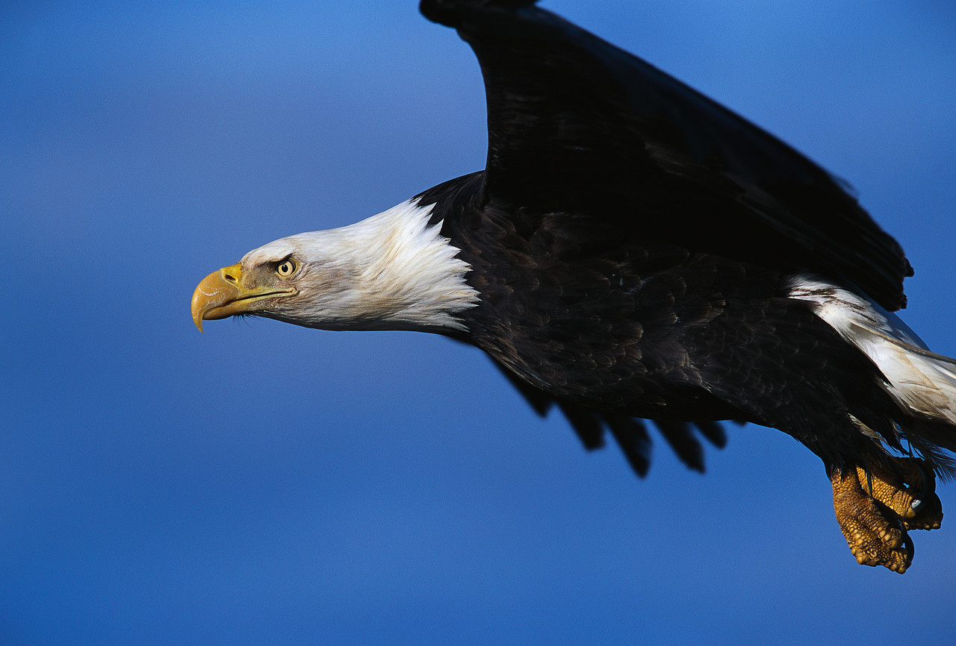
Exploring the Beyond
“Until you spread your wings, you will
have no idea how far you can fly”

Slide 2
Contact Information:
FS Appointments/MM Access
Email: Ann.Moran@kofc.org
Phone: 203 752 4717
Financial Secretary Training Consultant
Email: Pete.Karculias@kofc.org
Phone: 520-975-7362

Slide 3
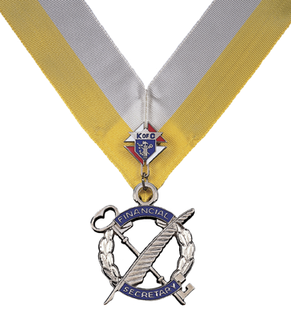
Financial
Secretary
Expectations
and
Responsibilities

Slide 4
Who is the Financial Secretary?
The financial secretary holds the more permanent office in the council and who has the ability, perseverance and trustworthiness to ensure the financial operations and member records of the council are accurate and completed on a timely manner.

Slide 5
Qualifications to be a FS
Must be at least 21 years of age and at least a third degree member
Must not be engaged in the sale of life or health insurance for another company
Should not hold another elected position in the council

Slide 6
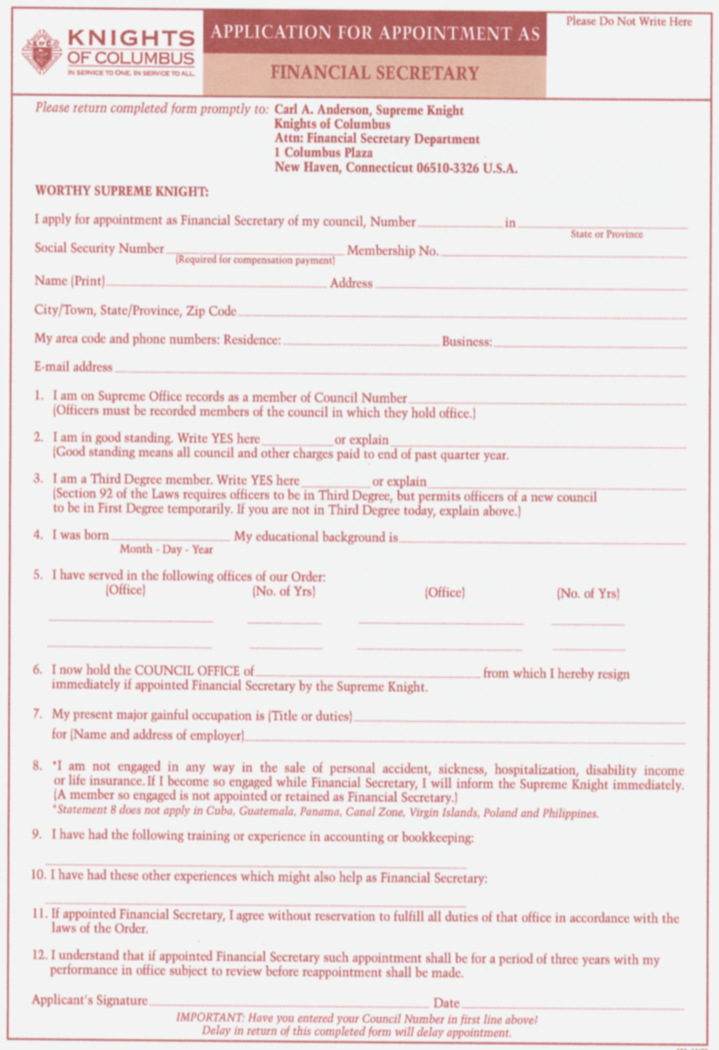
How appointed
Form #101-Application for Appointment as Financial Secretary.
Mailed from Supreme to GK upon resignation of current FS.
To be completed by all qualified and interested candidates.

Slide 7
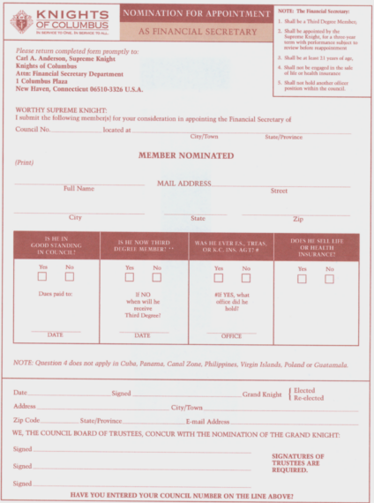
How appointed
Nomination form for Appointment as Financial Secretary
Form FS #103
GK nominates a candidate and trustees concur. Forms are forwarded to Supreme Knight for appointment

Slide 8
How Appointed
After recommendation by the Grand Knight and the Trustees, the Financial Secretary shall be appointed by the Supreme Knight for a three year term and shall hold office at the will of the Supreme Knight.

Slide 9
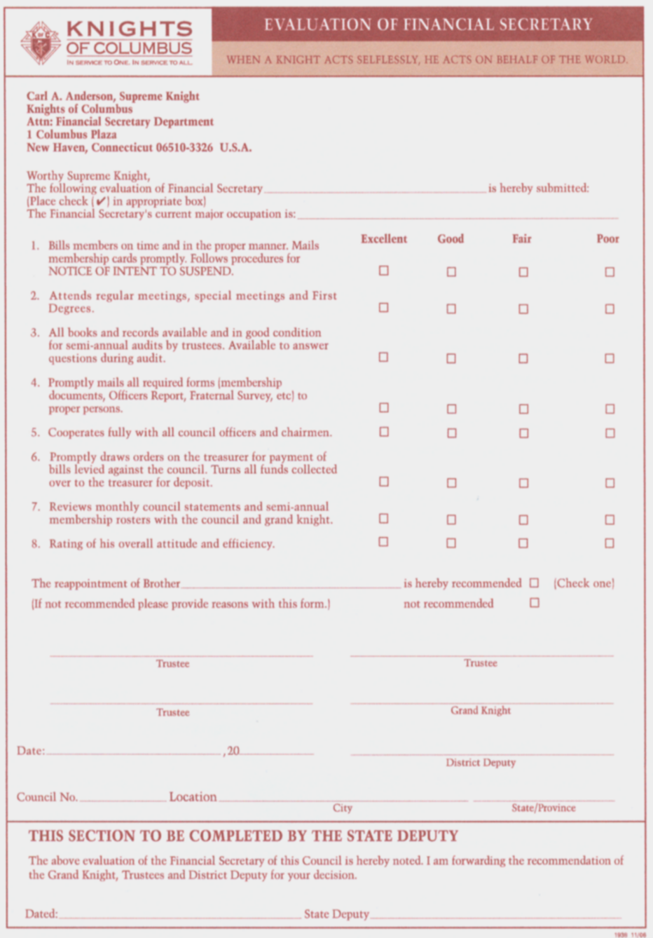
How appointed
Evaluation by Grand Knight and Trustees after the three year term.
The reappointment is endorsed by the State Deputy.

Slide 10
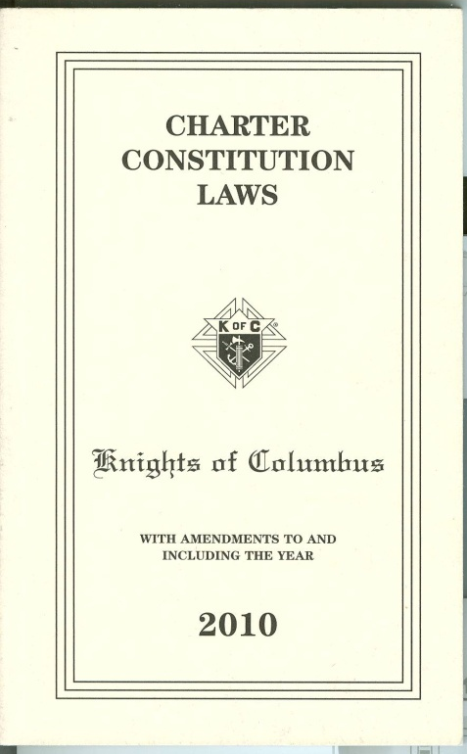
Charter Constitution Laws
Provides a very important link between Supreme, State and local Council
Studies and follows all regulations published in the Charter Constitution Laws of the Order in Section #139.

Slide 11
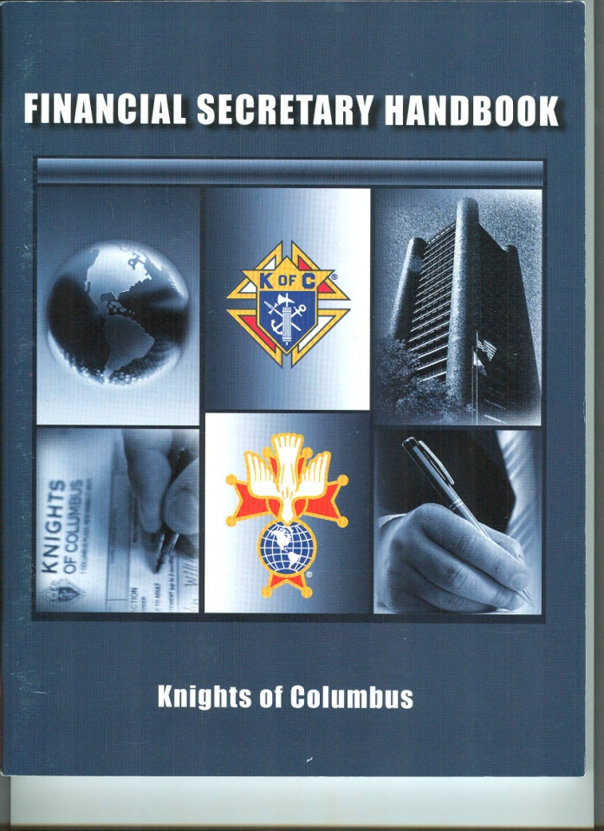
Financial Secretary Handbook
The Financial Secretary Handbook is your guide and answer book.

Slide 12
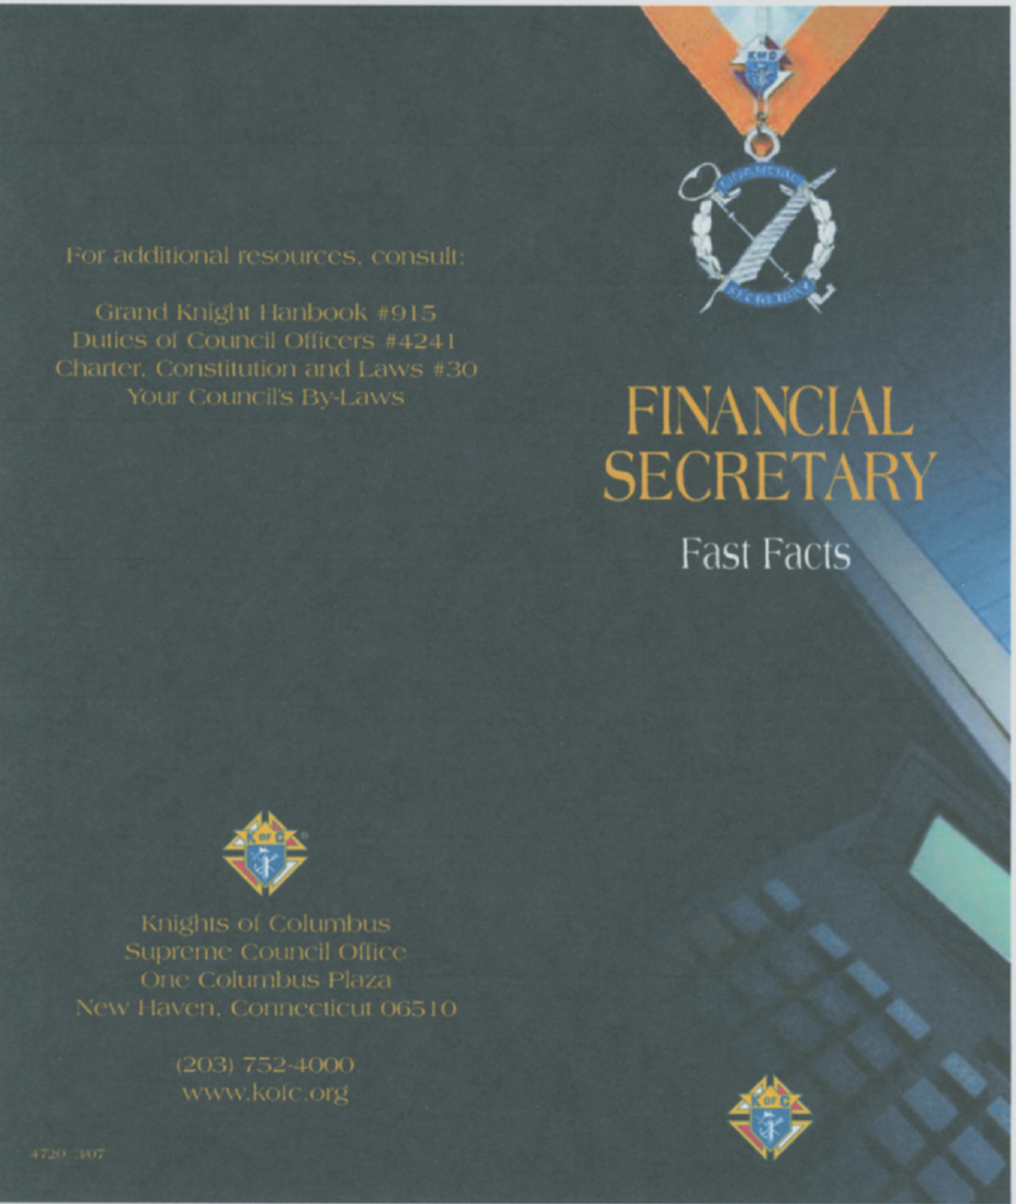
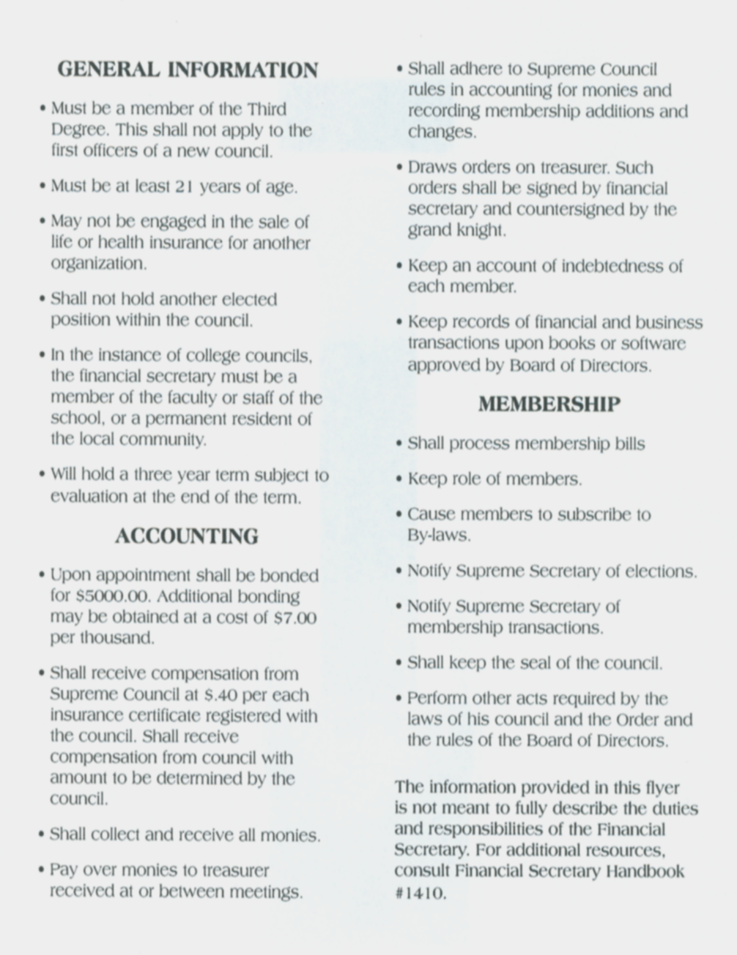
Duties and Responsibilities

Slide 13
Duties and Responsibilities
May collect compensation of 8 to 10% of dues collected and receive 40 cents from the Supreme Council for each insurance policy held by members and family members within the council.

Slide 14
Duties and Responsibilities
Bonded for $5,000 upon appointment and retains bond if audits are submitted to Supreme on a timely basis. Council treasurer is also bonded for $5,000 upon election to the position.
Bonds in jeopardy after failure to remit two completed audits in sequence.

Slide 15
Duties and Responsibilities
A Quick Synopsis
Collect and receive all money
Keep accounts
Transfer money to the Treasurer
Keep membership roll
Cause members to subscribe to by-laws
1
2
3
4
5

Slide 16
Duties and Responsibilities
A Quick Synopsis (cont’d)
Communicate with Supreme Secretary
Keep member records
Maintain financial records, draws orders
Process suspensions
6
7
8
9

Slide 17
Duties and Responsibilities
A Quick Synopsis (cont’d)
Notify candidate’s Grand Knight
Keeper of the council seal
Other duties
Notify fourth degree comptroller
10
11
12
13

Slide 18
Duties and Responsibilities
    Collect and receive all money from any source.
Dues from members
Fund raisers
Special collections
Any other funds
Social events
Athletic events

Slide 19
Duties and Responsibilities
    2. Keep an account of member records
Keep an account of the financial standing of all members.
Is the accountant for the council. Keeps council financial records.

Slide 20
Duties and Responsibilities
    3. Transfer all moneys received to the Treasurer. Gets receipt from Treasurer
Dues from members.
Contributions or donations.
.
Fundraisers.
All other sources.

Slide 21
Duties and Responsibilities
    4. Keeps roll of all members and policy holders (Active and inactive)
Age
Residence address
Dates of exemplification
Record of fourth degree members
Occupation

Slide 22
Duties and Responsibilities
    5. Causes members to subscribe to by-laws, etc
Ensures that every member before taking of the first degree exemplification, subscribe his name on the Constitutional Roll, thereby submitting himself to the laws and rules of the Order.

Slide 23
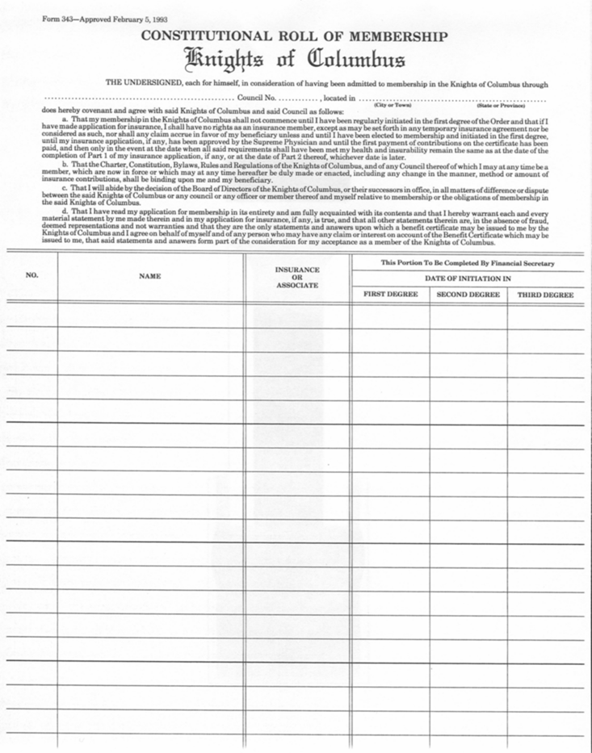
Constitutional Roll of Membership

Slide 24
Duties and Responsibilities
    6. Notify Supreme Secretary of the names and addresses of all council officers and other appointments. Assist the council officers in timely completion and ensure submission of all council forms.

Slide 25
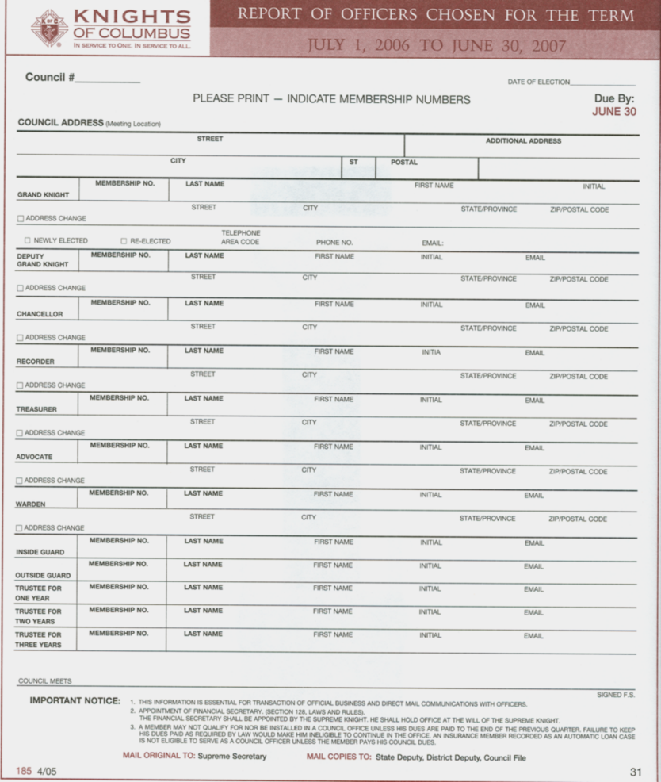
Form #185-Officers Chosen
Form #185 “Officers Chosen for the Term”
Submit before July 1st each year, even if all positions are not filled.
Use this form or use Member Management.

Slide 26
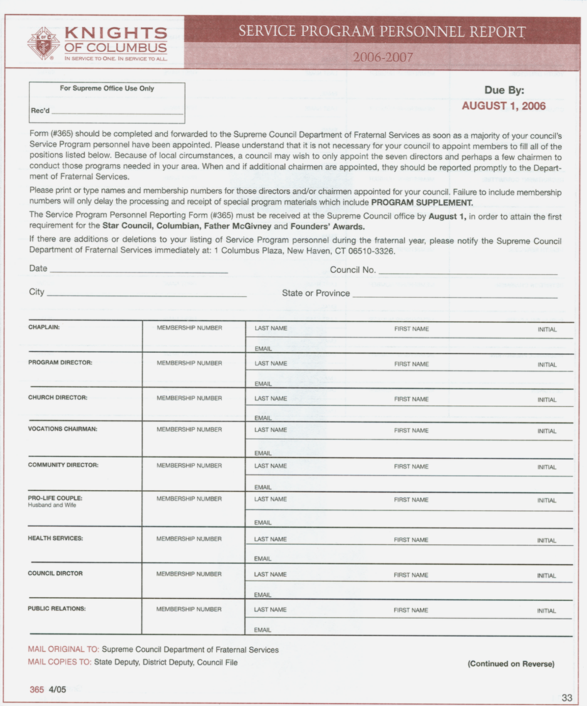
Form #365-Service Personnel
Submit annually before August 1st
Assist GK in preparing report
Use this form or Member Management
Required for Star Council Award

Slide 27
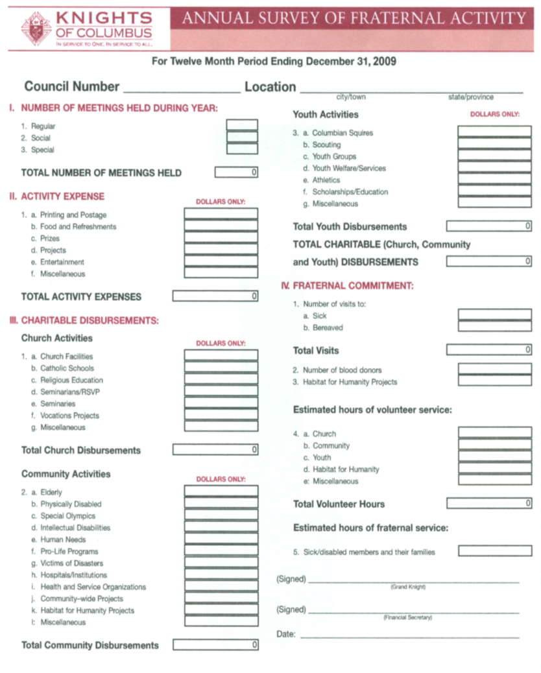
Form #1728-Fraternal Survey
“Annual Survey of Fraternal Activity”
Submit annually before January 31st.
Assist GK/Officers in preparation of report
Required for Star Council Award

Slide 28
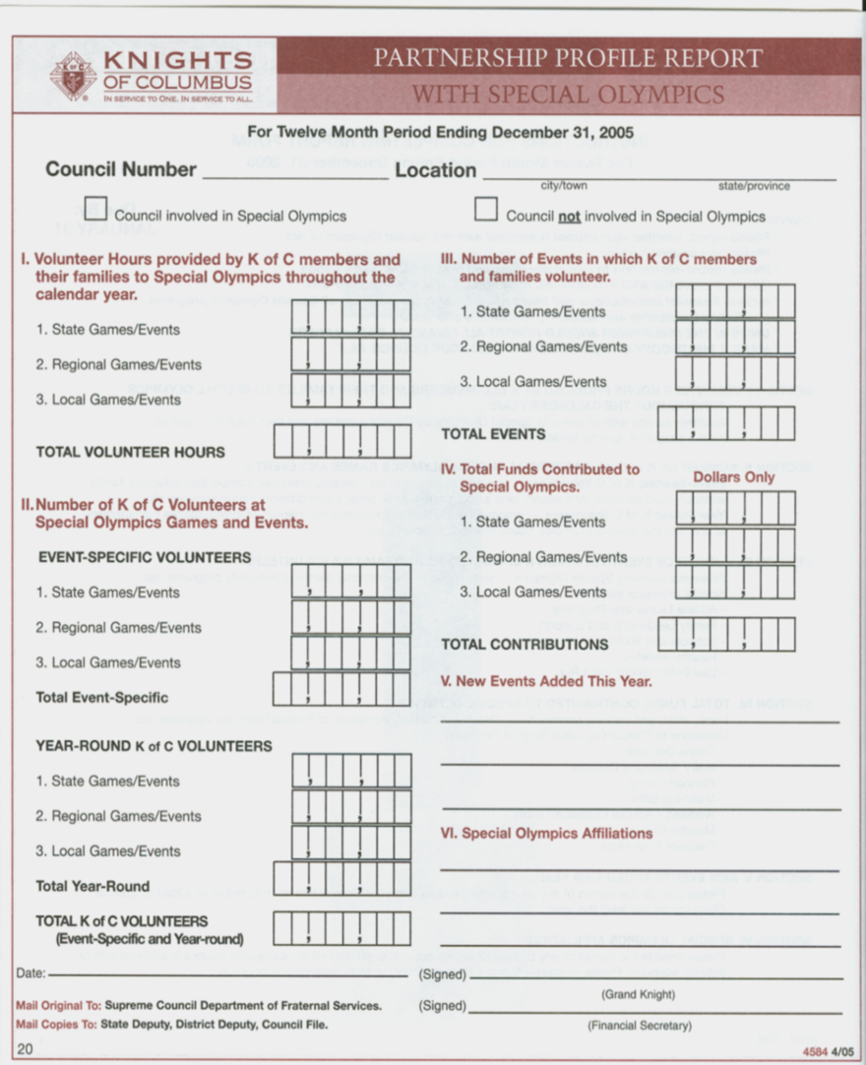
Form #4584-Special Olympics
“Partnership Profile Report with Special Olympics”
Submit with Fraternal Survey before January 31^{st each year.}
Assist GK/Officers in preparation of report

Slide 29
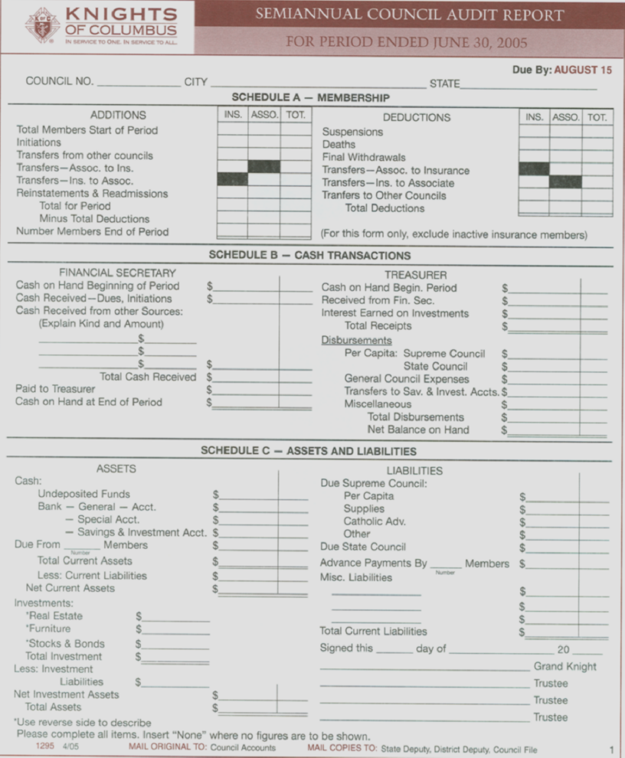
Form #1295-Audit Report
Due Feb 15/Aug 15
Give info to GK and Trustees. By law, they prepare and sign.
Maintain $5,000 bond
Insure safety of council funds
Cannot be submitted on-line (Signatures)
Click for how to do an Audit

Slide 30
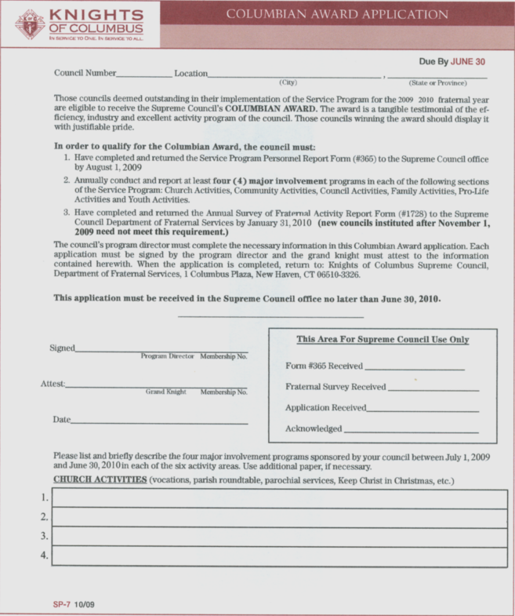
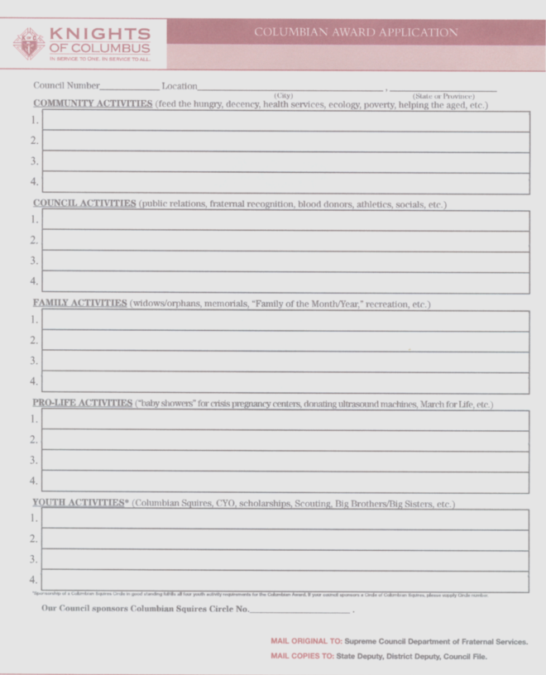
Form #SP7-Columbian Award
GK and Program Chairmen to complete
Due prior to June 30th each year
List four activities in six program categories.
Required for Star Council Award

Slide 31
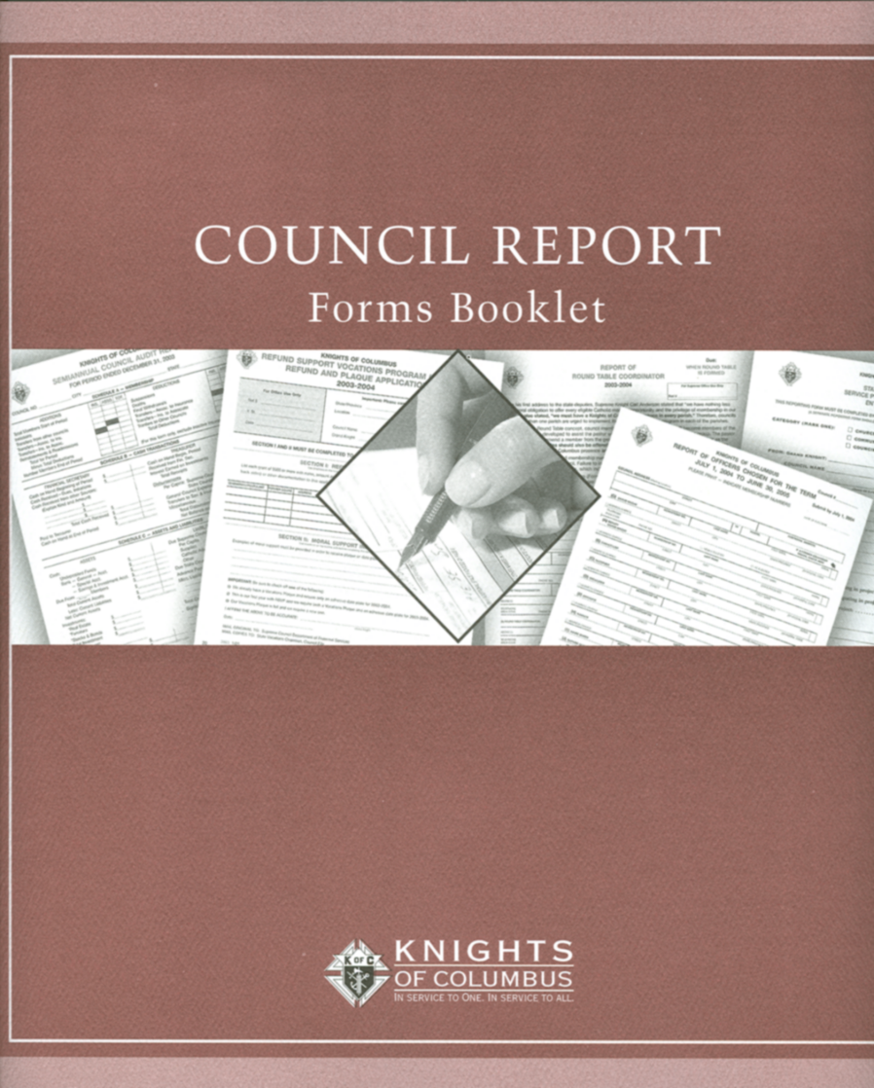
Council Report Forms Booklet
Council Report Forms Booklet
FS should have copy
Remind officers of due dates and assist with form preparation and submission.

Slide 32
Council Report Forms Booklet
To View Forms on the K of C Website
Click on www.kofc.org and go to For Officers and then Forms on the Orders Website. Select council for respective council forms

Slide 33
Duties and Responsibilities
    7. Keeps record of all transactions
Names of prospective candidates
Keeps record of all money received and paid to the Treasurer
Names of members initiated
Number of degrees taken be each member
Names of elected candidates

Slide 34
Duties and Responsibilities
    8. Draws orders and records other financial transactions
Receives all council checks and cash
Publishes financial reports
Prepares expense vouchers
Records all financial transactions
Prepares receipts

Slide 35
Basic financial process
Handling Cash
FS Receives
Cash
FS Turns
Cash Over
To Treasurer
Treasurer
Fills Out
Receipt
FS Retains
Signed
Receipt
Treasurer
Deposits
Cash
Treasurer
Retains
Receipt
Copy

Slide 36
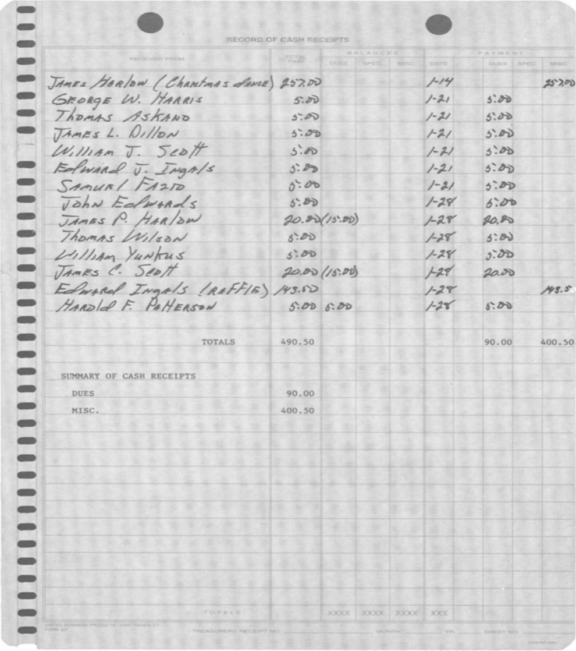

Basic Financial Process
Record of Cash Receipts (Manual)
Copy to Treasurer with cash and checks.
Christmas Dance
Dues
Raffle

Slide 37
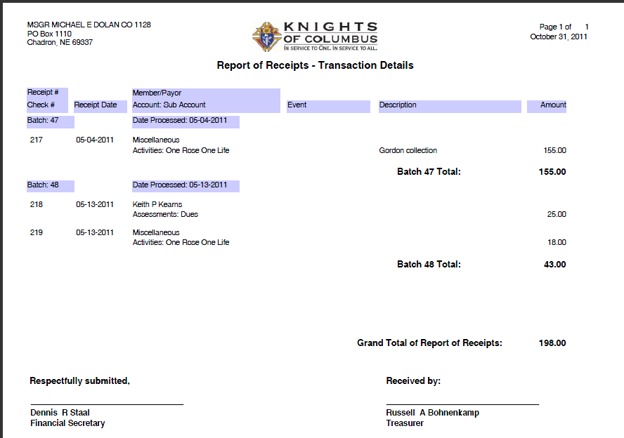
Basic Financial Process
Record of Cash Receipts (MB)

Slide 38
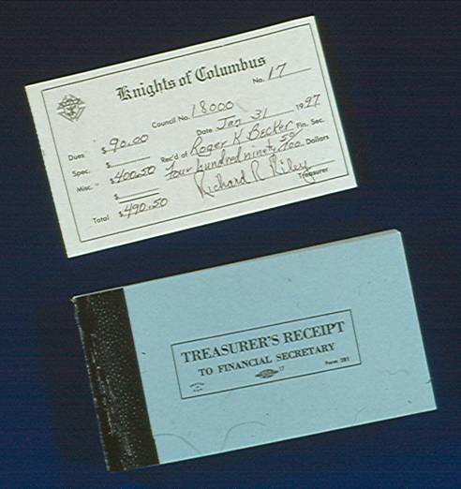
Basic Financial Process
Example of Treasurer’s Receipt to Financial Secretary
Receive for all funds transferred to the council treasurer
Trustees use to verify records during audit

Slide 39
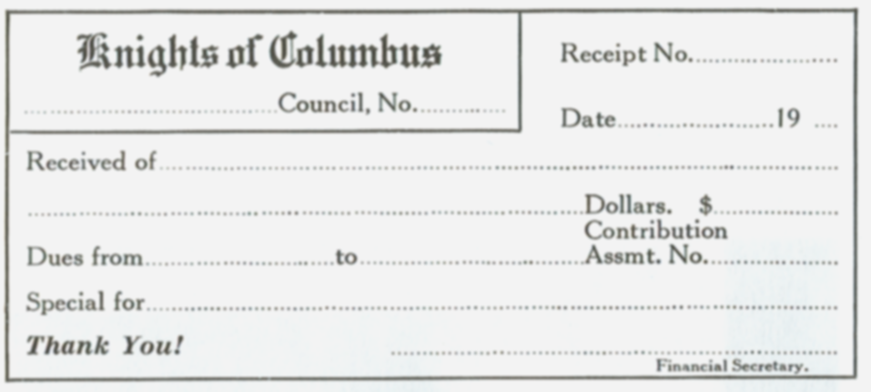
Basic Financial Process
Receipt for Cash
Issue to members for fundraisers and other monetary collections
Membership card is substitute for receipt.

Slide 40
Basic financial process
Paying Non-Budgeted Bills
FS Receives
Bill
Bill Reviewed
By
Trustees
FS Reads
Bill At
Meeting
Bill
Approved
By Council
Treasurer
Writes
Check
Voucher
Given to
Treasurer
Voucher
Signed By
GK & FS
FS Prepares
Voucher

Slide 41
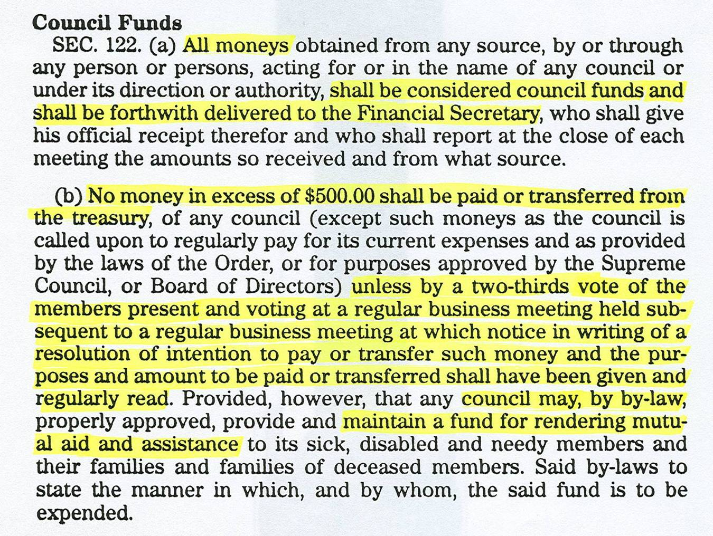
Basic financial process

Slide 42
Basic financial process
Bills that can be paid without council approval:
    Supreme per capita which now includes Catholic Advertising
    Supply invoices from Supreme
    State per capita and assessments
    Budgeted expense items pre-approved by majority of council membership at a regular business meeting

Slide 43
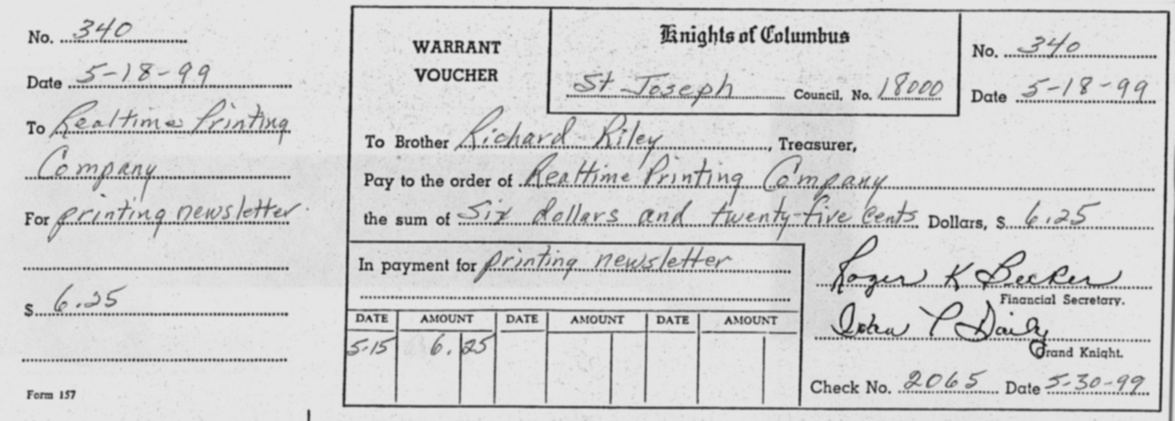
Duties and Responsibilities
Draws all orders (vouchers) after council approval
Check No.
#157 – Signed by FS and GK, Given to Treasurer

Slide 44
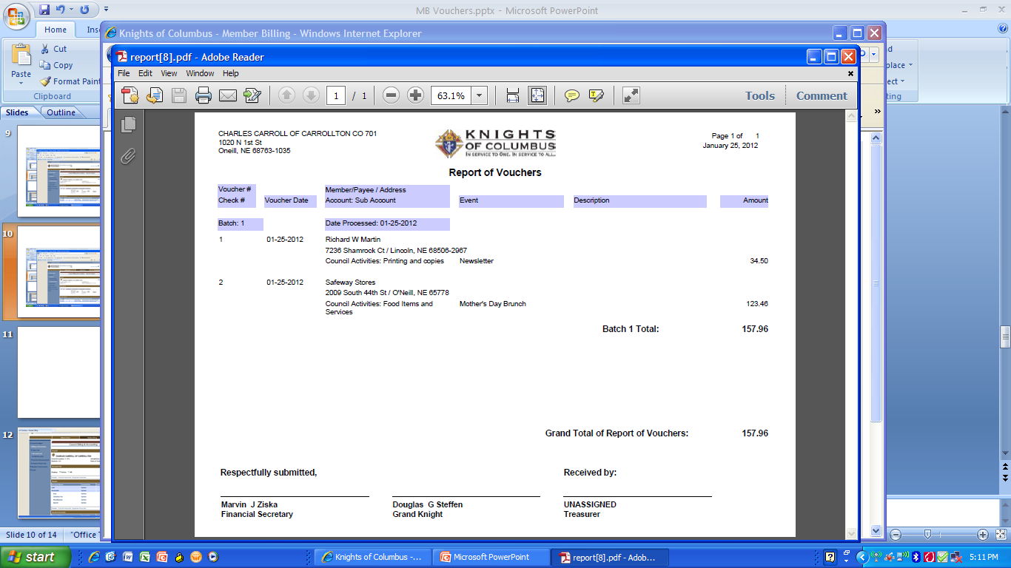
After approval by council membership, vouchers are now ready for signatures of the officers shown below and processing for payment. Member Billing Format

Slide 45
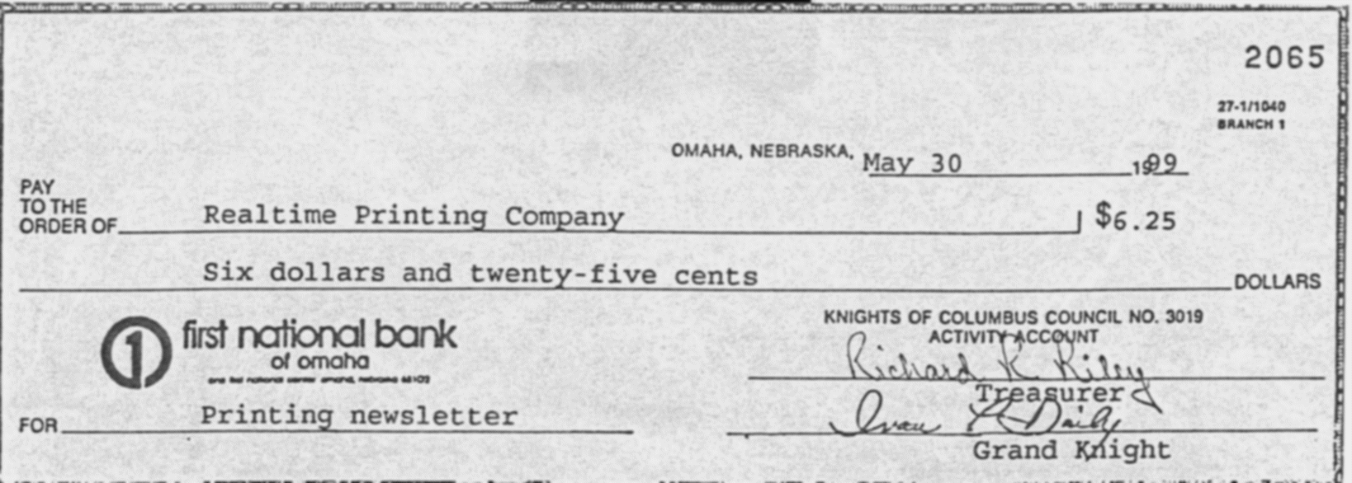
Duties and Responsibilities
Treasurer writes or prints check
Signed by Treasurer and Grand Knight.
“Financial Secretary is not authorized”

Slide 46
Duties and Responsibilities
    9. Notify Supreme Secretary of membership
    transactions. Use form #100 or Member Management
    - Report members initiated, suspended, expelled, deceased, readmitted etc, transfers into the council and any other data changes.
    - Prompt reporting is crucial

Slide 47
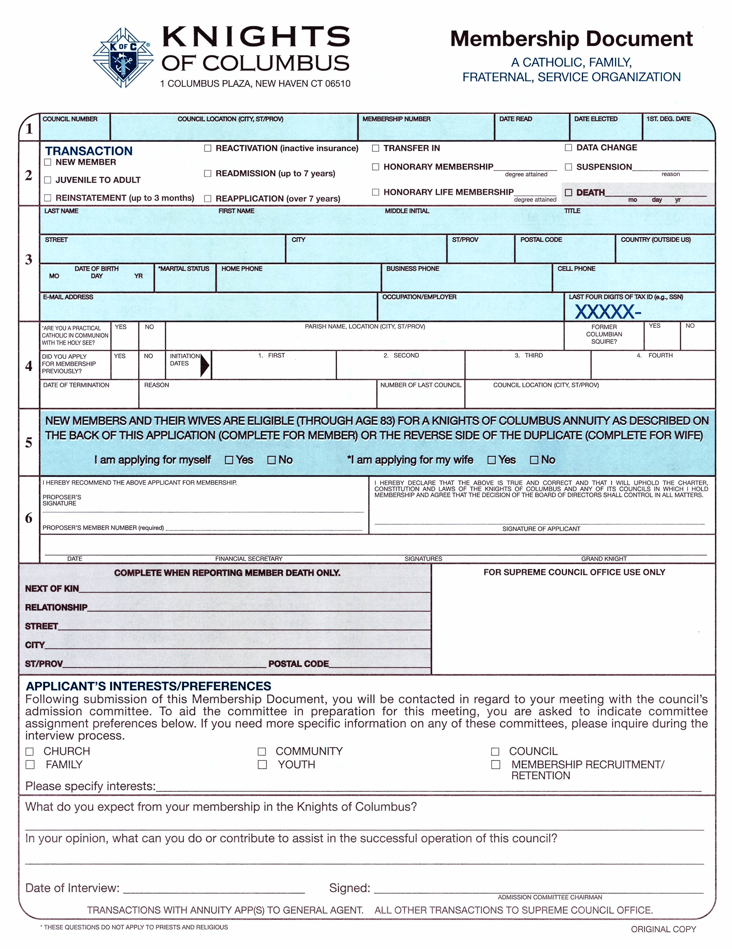
Membership Document:
Form #100-1A Revised 12/11

Slide 48
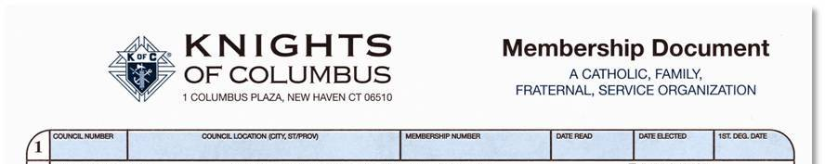
Proper Completion of Form #100
Section #1
Omaha, Nebraska
1234567
10909
10/3/100
10/3/10
10/8/10
Council Number
Date Application Read
Council Location (City and State)
Date Member Elected
Membership Number, if known
First degree date

Slide 49
Proper Completion of Form #100
Section #2
x
x
New Member – Check this box.
Juvenile to Adult- When a man joins the Order who has an insurance policy issued on him prior to18 years of age.

Slide 50
Proper Completion of Form #100
Section #2
x
Reinstatement- Use when the member rejoins the Order after being suspended less than three months.
No break in service, no loss of benefits.
Must join the same council from which he was suspended. Certain exceptions may apply.

Slide 51
Proper Completion of Form #100
Section #2
x
x
Reactivation – Member who has insurance with the Order becomes an active dues paying member. Fee is $5.00 without withdrawal card
Readmission –Member who has been out of the Order for more than 3 months but less than 7 years. Fee is $7.50 without withdrawal card.

Slide 52
Proper Completion of Form #100
Section #2
x
x
Reapplication- Former member who has been suspended for over 7 years rejoins the Order. Fee is $7.50 without withdrawal card.
Transfer In- an active member in another council transfers into your council. Only the incoming council can initiate the move

Slide 53
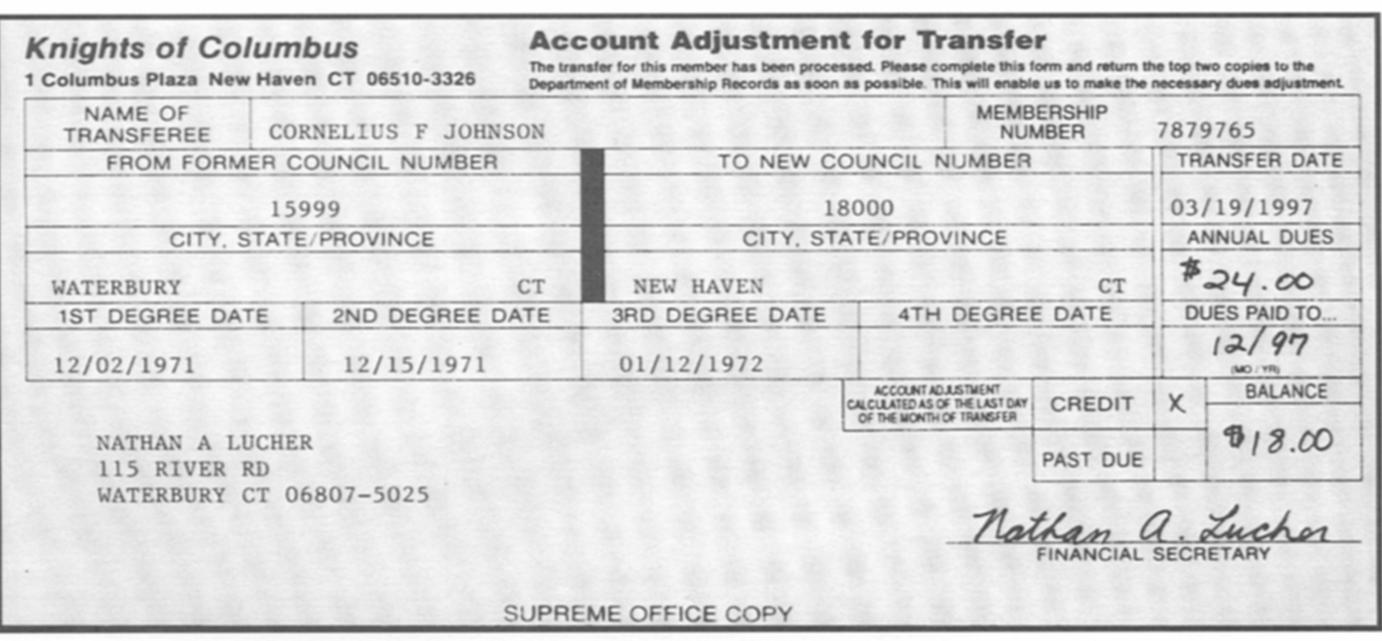
Account Adjustment for Transfer
Membership Records mails this form to the member’s former council for degree information, dues owed or paid.
Supreme will not assess back dues more than one year.

Slide 54
Proper Completion of Form #100
Section #2
x
x
Honorary Membership –Member has reached the age of 65 and has 25 years of consecutive service. Former members maybe eligible.
Honorary Life Membership –Member has reached the age of 70 with 25 years of consecutive service, or age 68 with 50 years of service. Again former members may be eligible. Priests and Religious Brothers are HL

Slide 55
Proper Completion of Form #100
Section #2
x
x
Data change – Use when making changes to a members record, such as address, phone number, degree dates etc. Preferred input method is through member management on the K of C Website.
Suspension - After 60 days and before 90 days of submitting the #1845 Notice of Intent to Suspend, mark suspension and state reason.

Slide 56
Proper Completion of Form #100
Section #2
x
Death - Notify membership records of the month, day and year of the death of a member. Provide proof of death. Use obituary or website ‘Social Security Death Index’ for death date. If reporting on Member Mgmt, no tangible proof is necessary.

Slide 57
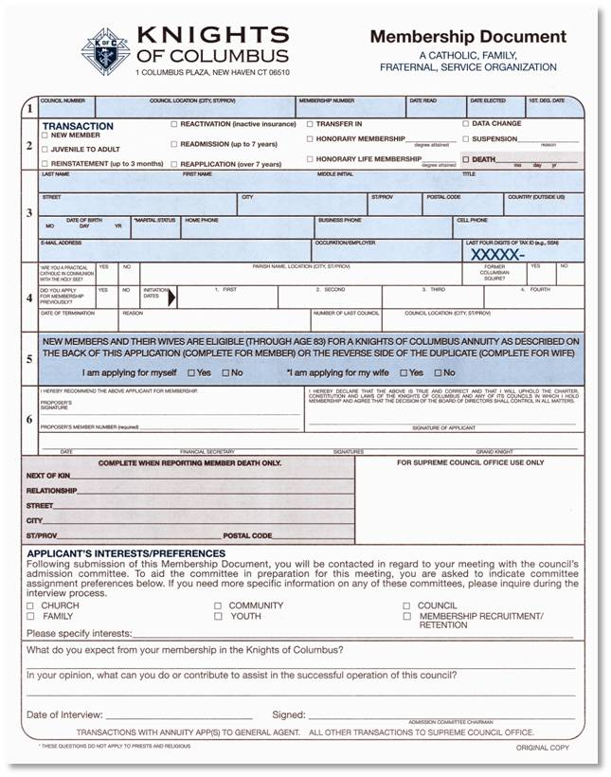
Proper Completion of Form #100
Section #3
Seacrest Jerald K Dr
5687 Seward Street Oakland Ohio 40987 USA
10/31/48 Married 203-567-9008 203-567-9009 203-456-9787
Seacrest@gmail.com Cardiologist 2390
Name and Address - Complete and Legible
Date of Birth, Marital Status, Phone numbers
E-mail address, occupation and last four digits of SS#

Slide 58
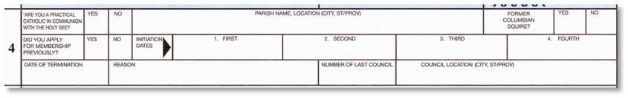
Proper Completion of Form #100
Section #43
x
x
St Mary’s, Bellevue, WA
x
4/6/88
5/22/88
12/12/88
5/2/89
6/4/95
Job relocation
7740
Omaha, Nebraska
Parish Name and Location
Former Columbian Squire
Degree Dates
Former council information

Slide 59
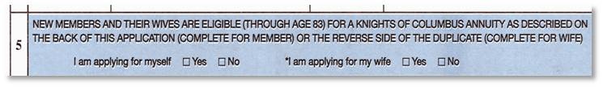
Proper Completion of Form #100
Section #53
New Member Annuity Interest
Available for Member and Spouse
FS forwards top copy of Form #100 to General Agent when interest is indicated in an annuity. Use transmittal form #175FS.

Slide 60
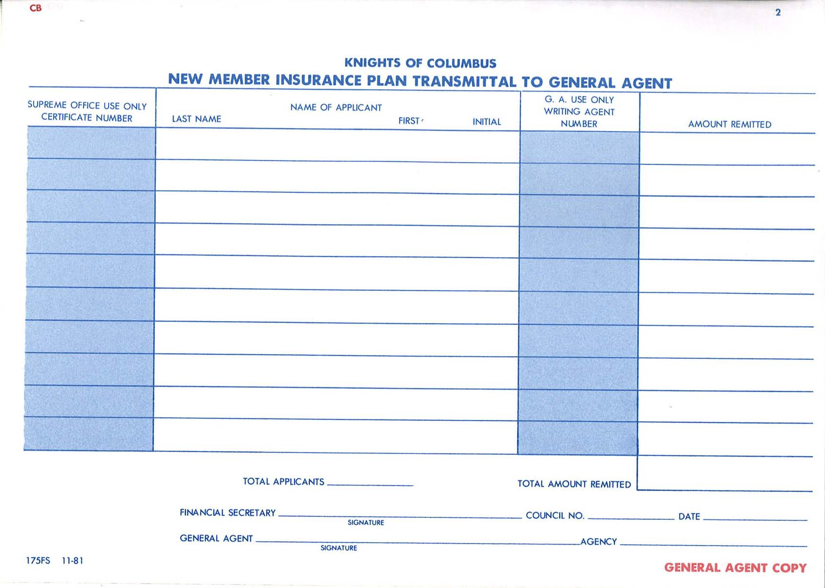
Copy of transmittal to General Agent #175FS

Slide 61
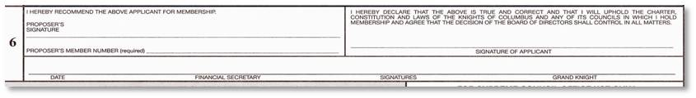
Proper Completion of Form #100
Section #63
Rod J Hofschulte
x
1590186
9/3/10
x
x
Proposer Name and Number
Signature of Applicant
Date, Signature of Financial Secretary and Grand Knight

Slide 62
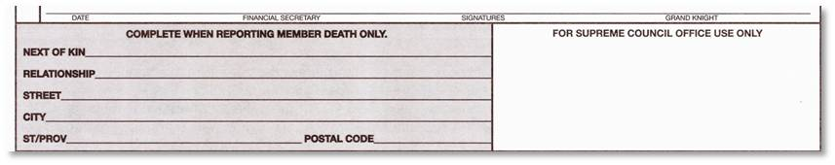
Proper Completion of Form #100
Use when reporting member death
Letter of condolence sent if reported within 6 months
Report on Form #100 or use Member Management

Slide 63
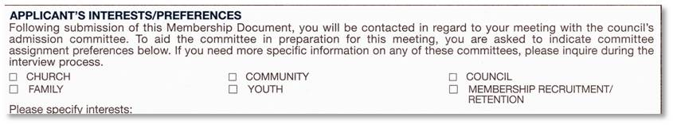
Proper Completion of Form #100
Use to solicit member activity interest
Use as prelude to admission committee meeting and assignment to a team or council’s activity director for active involvement.

Slide 64
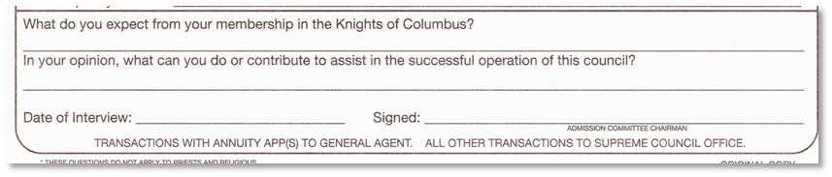
Proper Completion of Form #100
Solicit member expectations and anticipated contribution to the council’s success.
Date of interview and signature of admission committee chairman.

Slide 65
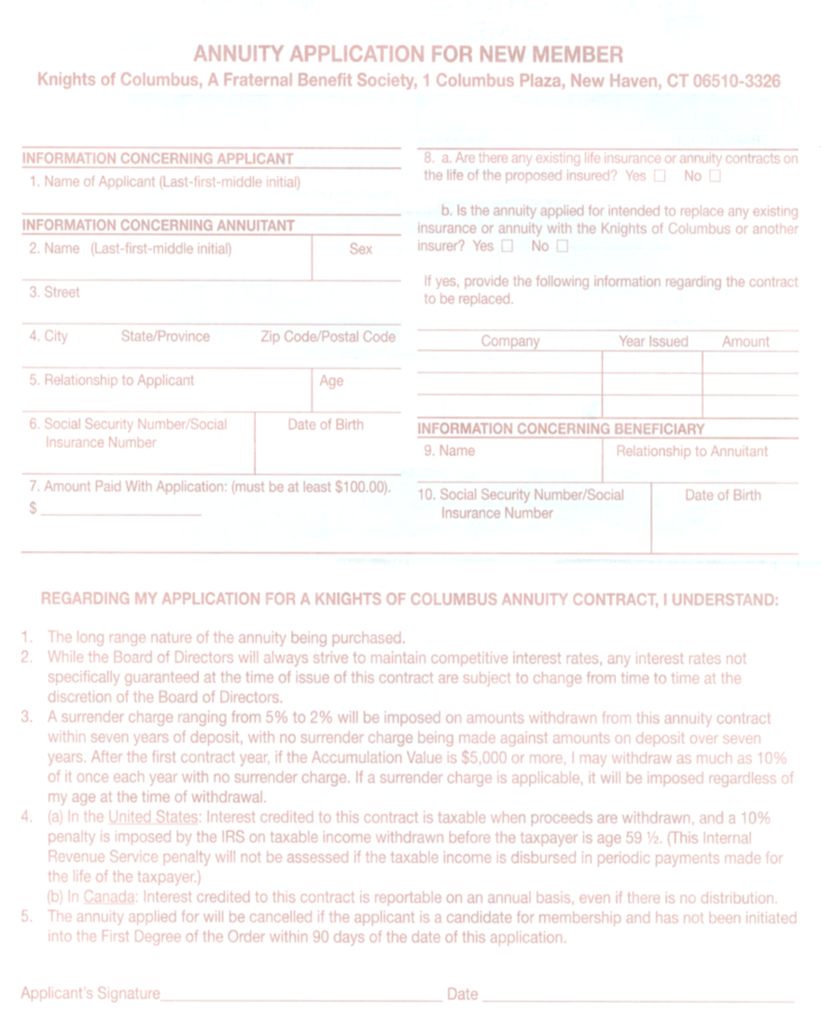
Proper Completion of Form #100
On the reverse of Form #100 is the applications for both the new member and spouse to open an annuity with the Order.
Upper section 1-10 is applicant information.
Lower section 1-5 is understanding the contract and signature

Slide 66
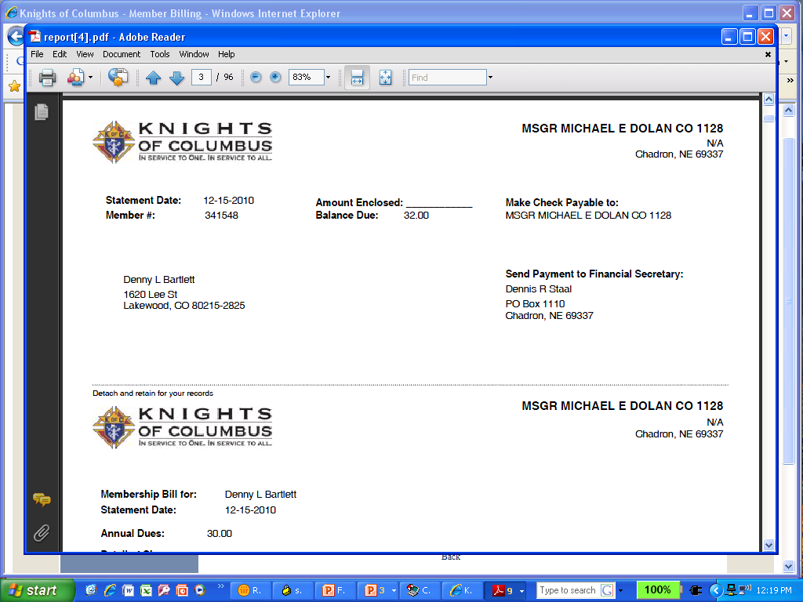
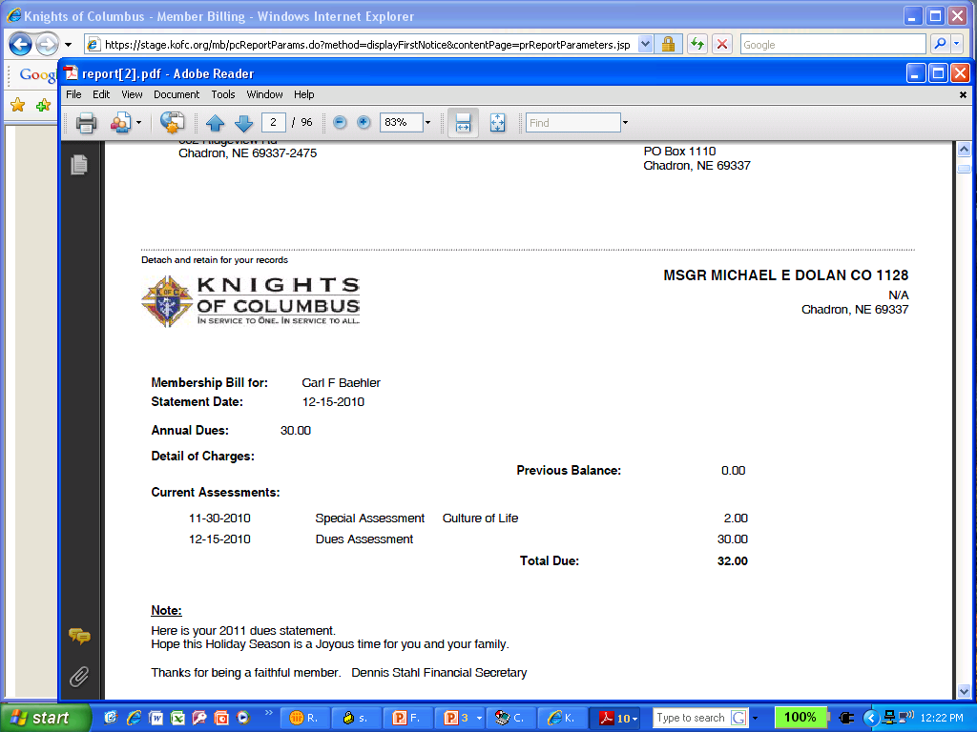
Billing Process
First billing statement.
Billing should be made 15 days prior to the billing period or approximately December 15^{th .}
Second billing by January 15th

Slide 67
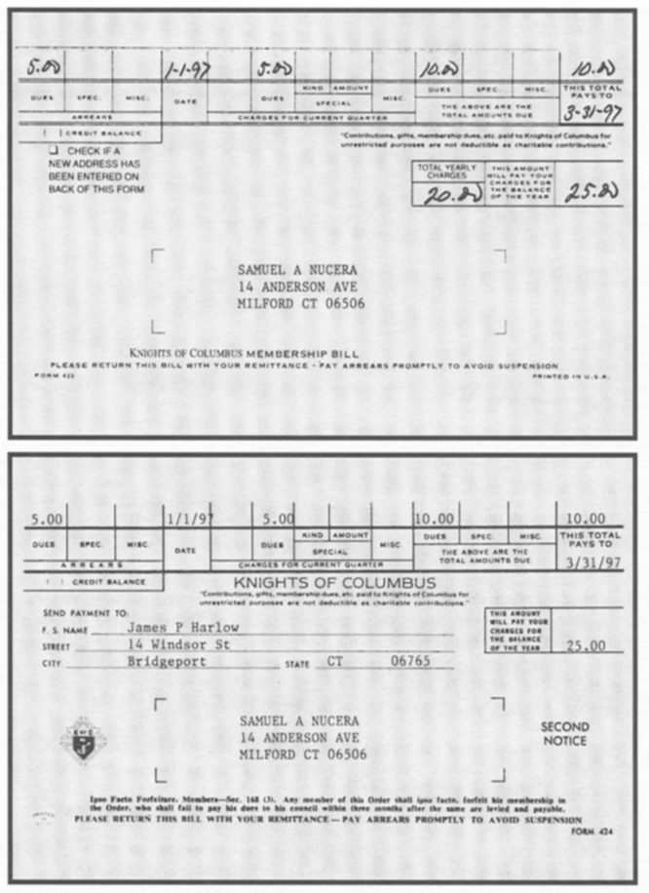
Billing Process-Manual
First notice of dues owed use Form #423 and for second notice of dues owed use Form #424.
First billing mailed about December 15th and second billing 30 days after first billing. Approximately January 15^{th.}

Slide 68
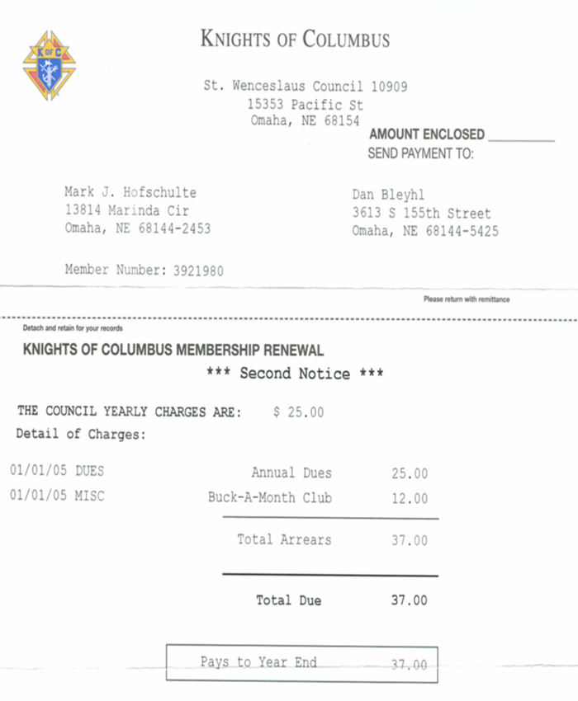
Billing Process
Second notice of dues owed.
Billing should be made 30 days after first billing. Approximately January 15^{th.}

Slide 69
Next step - Personal Visit
Retention starts the day they join
and
“IT IS EVERYBODY’S BUSINESS”!
But when a member is in arrears on dues, someone from the retention committee makes a personal visit to the member and spouse to explain benefits of membership.

Slide 70
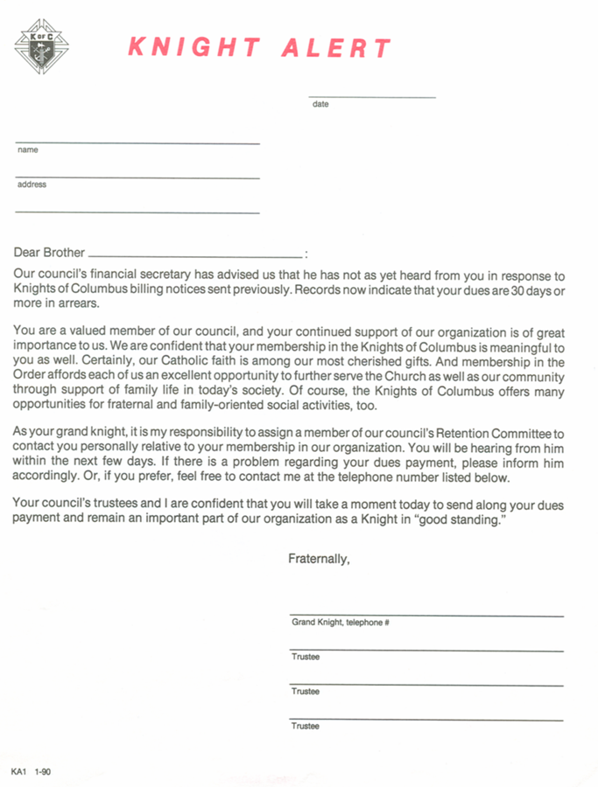
Billing Process-Suspensions
On February 15th alert the Grand Knight and Retention committee of members in arrears. Retention committee is made up of GK, DGK, Trustees, Field Agent and Proposer. DGK is key.
Grand Knight and Trustees mail member Knight Alert.
Members of committee visit delinquent member.

Slide 71
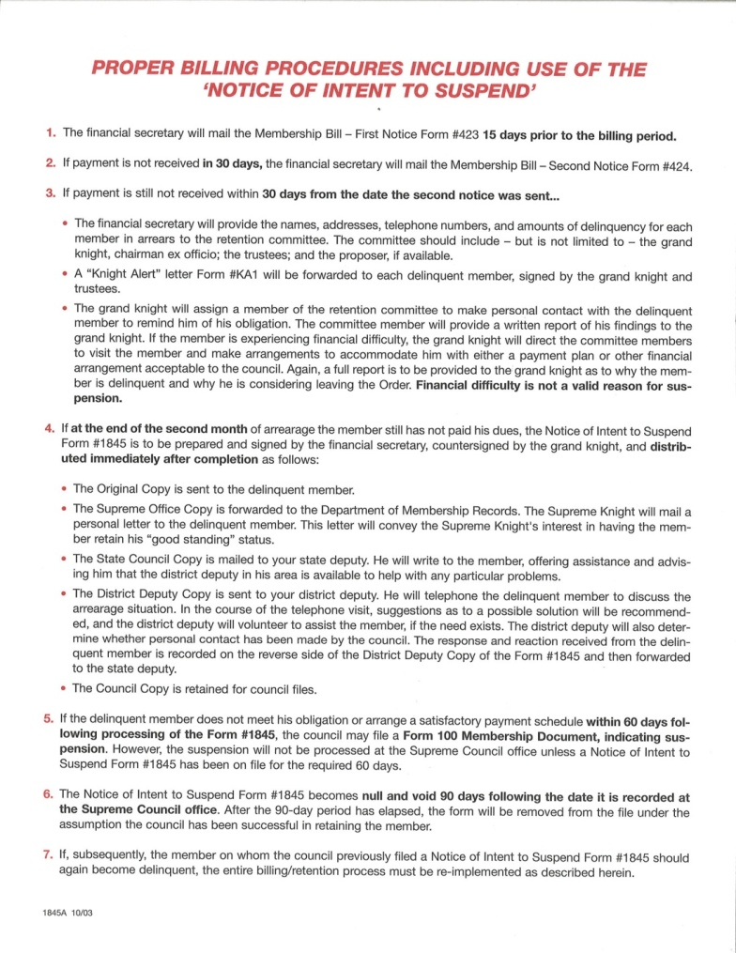
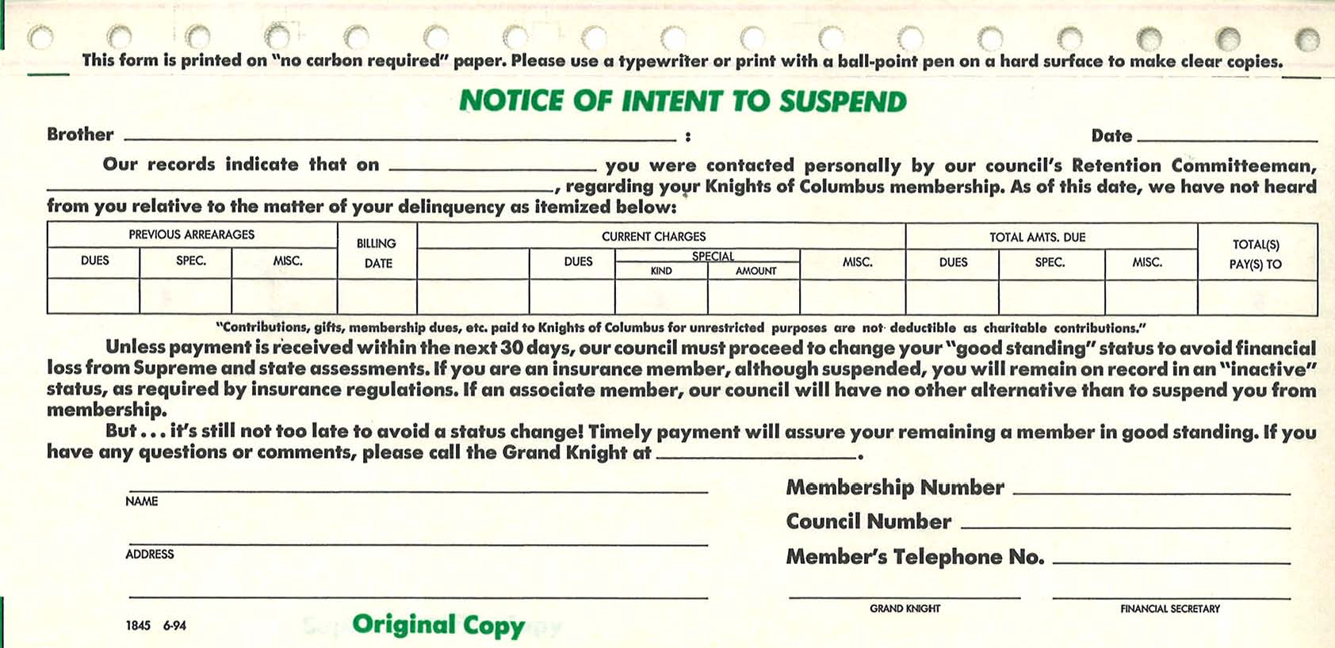
Billing Procedures - Suspension
Suspension Forms
Form #1845
Form #1845a

Slide 72
Billing Process-Suspension Form #1845-Notice of Intent to Suspend
Mail original copy to delinquent member
Mail copy to Supreme. Supreme Knight conveys his interest to the member via letter.
Mail copy to State Deputy. Gives advice
Mail copy to District Deputy. He calls
Council retains council copy

Slide 73
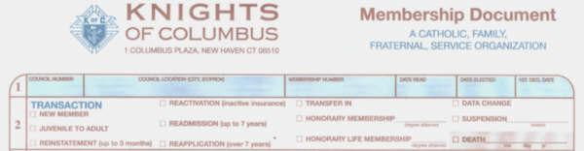
Form #100- Suspension
    Suspension: - After 60 days from submission of #1845 to Membership Records at Supreme and before 90 days, council must submit Form #100 indicating suspension and the reason.
    - Assumes you did all you could to retain him

Slide 74
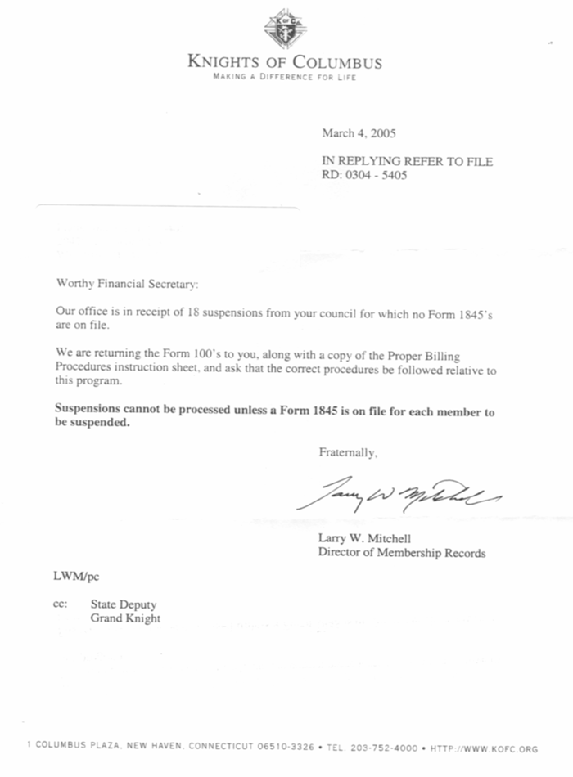
Notice of improper procedure
When an error in procedure occurs in suspending a member, the Supreme Council Membership Records Dept will inform the FS.
Example letter at left.

Slide 75
Retention Responsibilities
Maintain information on proposers
  Keep separate file of proposers or maintain record of all Form #100s
    For notifying members of degree exemplifications
    For follow up in the event of a suspension possibility.
    List maintained in Member Management

Slide 76
Reasons we should never suspend
Member has financial difficulty and unable to pay dues. Should pay from council’s charity fund or waive dues.
Medical problems which deter his ability to earn income or if total disability, then have completed Form #1831.

Slide 77
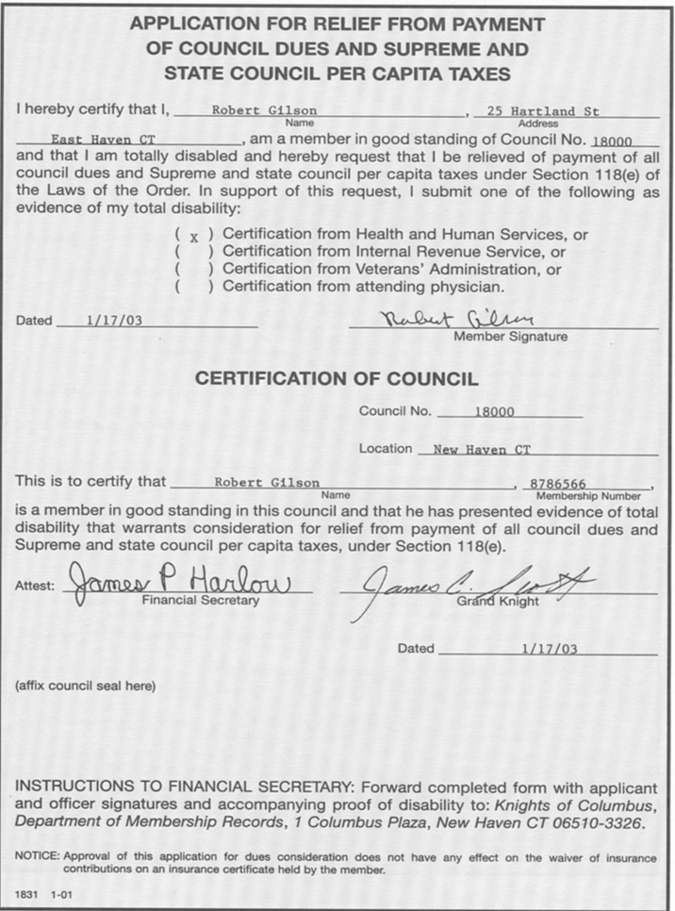
Disability Waiver Form #1831
Application for Relief from Payment of Council Dues and Supreme and State Per Capita Taxes
Completed by member, attested to by GK and FS
Must renew annually.

Slide 78
Suspensions which may not affect award quotas
Suspension-Failure to remain Catholic.
Requires letter from member or pastor attesting to this fact.
Suspension-Felony conviction.
Requires newspaper account of conviction or court documentation
(Generally use ‘one year and one day’ guideline)
Suspension-Misconduct.
For violating the Order’s laws

Slide 79
Conservation steps recommended for Council Retention Team to Follow
Click here to follow: Flow Chart on PPt
Click here to follow: Flow chart in Word

Slide 80
Withdrawal Procedures
Effective October 1st, 2003.
No longer use Form #100 for withdrawal
Member must send a personal letter, signed by him and mailed to Membership Records Department at Supreme Council Office.
All members will be expected to pay a re-entry fee upon returning to the Order.

Slide 81
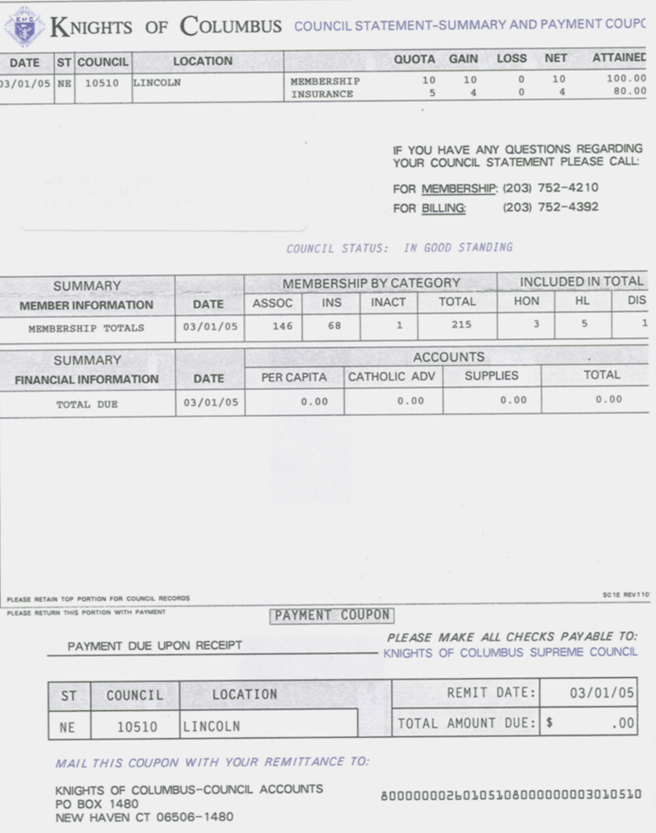
Statements and Rosters
Council Statement-Summary and Payment Coupon
Received monthly from Supreme
Verify accuracy of information, quotas achieved, etc
Payment coupon for remitting money owed to Supreme

Slide 82
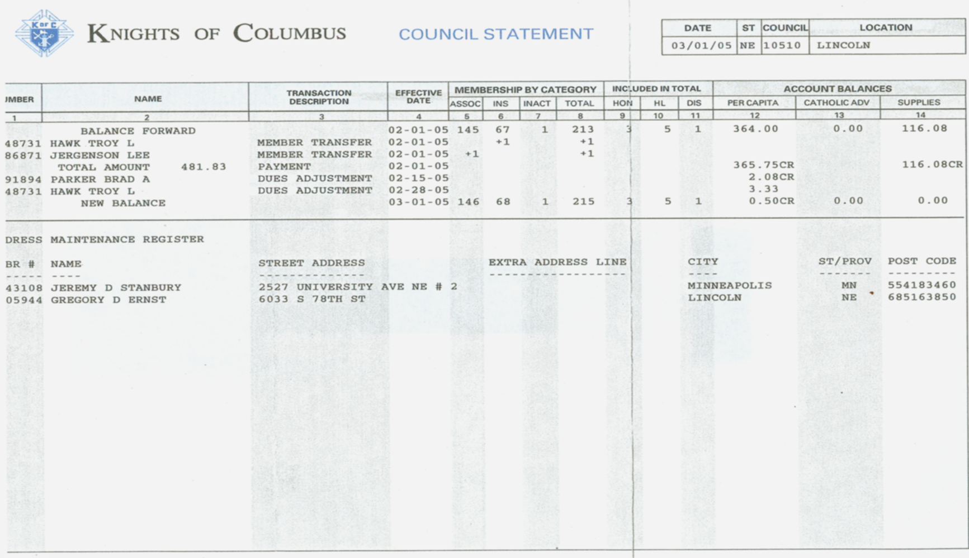
Statements and Rosters
Transfer in
Transfer out
Payment made
Address maintenance area

Slide 83

Statements and Rosters
Receive this semi-annual roster from Supreme

Slide 84
Duties and Responsibilities
10. Notify Candidate’s Grand Knight
When a candidate receives degrees at a council in which he is not a member, the Financial Secretary must then notify the candidate’s council of the degrees.

Slide 85
Duties and Responsibilities
11. Keep seal.
Keep official seal of council and affix the same to all official documents, papers, membership cards, etc

Slide 86
Duties and Responsibilities
12. Notify Fourth Degree Comptroller.
Provides address changes, status changes, etc to the Comptroller for his records. Also refer all members interested in becoming a fourth degree member to him.

Slide 87
Duties and Responsibilities
13. Other duties.
Perform all other acts as required
Keep record of ceremonial books
Order supplies as needed or requested by Grand Knight.
Attend regular and officer meetings
Provide Field Agent with assistance

Slide 88

Duties and Responsibilities
Other duties:
Distribute materials sent
from Supreme or State
Council to Grand Knight
as indicated. Example:
Surge with Service CDs
sent in April or May

Slide 89

Duties and Responsibilities
Form #1 Supply Order Form
Use 800 266 6340 to fax or mail requests.

Slide 90

Duties and Responsibilities
Prepare Form #990 or similar document for IRS
Fraternal Benefits Society 501(c)(8)

Slide 91
Duties and Responsibilities
Federal Income Tax Information – Form 990
ALL councils must file one of the following:
990N - Gross receipts not exceeding $50,000
(electronically only, available at www.irs.gov)
990EZ – Gross receipts over $50,000 and up to $200,000
990 – Gross receipts over $200,000
Failure to file 3 consecutive years will result in a
loss of tax exempt status!

Slide 92
Duties and Responsibilities
Federal Income Tax Information – Form 990
The Knights of Columbus is organized under IRS code (501) (c)(8), a fraternal benefits society.
Most councils are exempt from income tax.
Must provide EIN number to Supreme Advocate.
Solicitations are not deductible for tax purposes.
When filing for the first time do not use the words Supreme council, use Knight of Columbus and council name.

Slide 93
Star Council
Program Personnel Reported
Form #365 Due by August 1
Membership
Quota= 3 or 7% and participate in 4 first degrees Use Form #450c
Insurance
Quota=3 or 2.5%
Per Capita Tax Paid
Fraternal Survey
Form #1728 Due by Jan 31st
Columbian Award
SP-7 Due by June 30th

Slide 94
To Accomplish your Mission: Have the Will to Prepare and…
The Will to Succeed!
You can be a great help to your council by providing guidance and advice. Insure that all forms are filed on time, all council records are maintained and your council continues to grow in membership and activities.

Slide 95
FOR ALL YOU DO..
Thank You!

