Slide 1
Member Billing and Council Accounting for Financial Secretaries

Slide 2
Member Billing
Welcome and Orientation

Slide 5
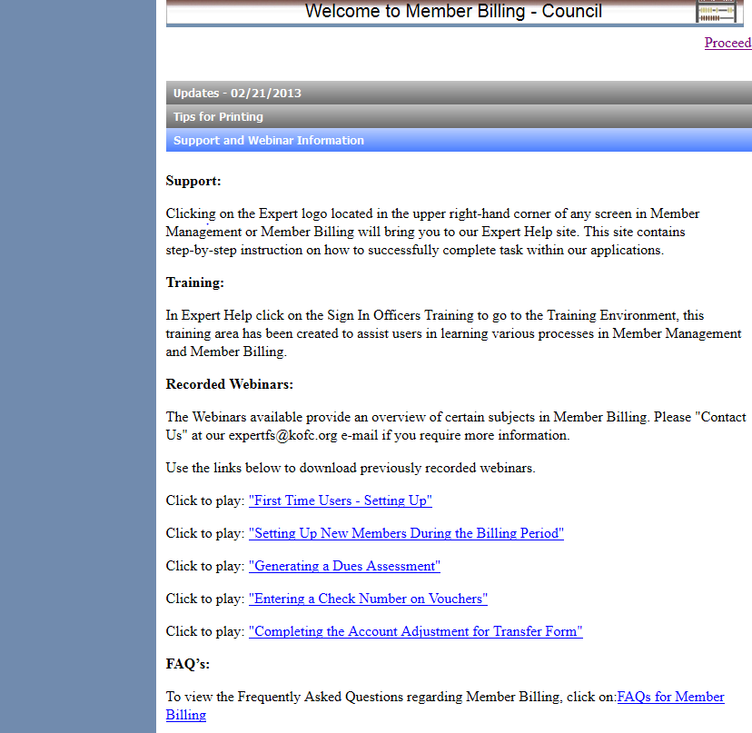

Slide 7
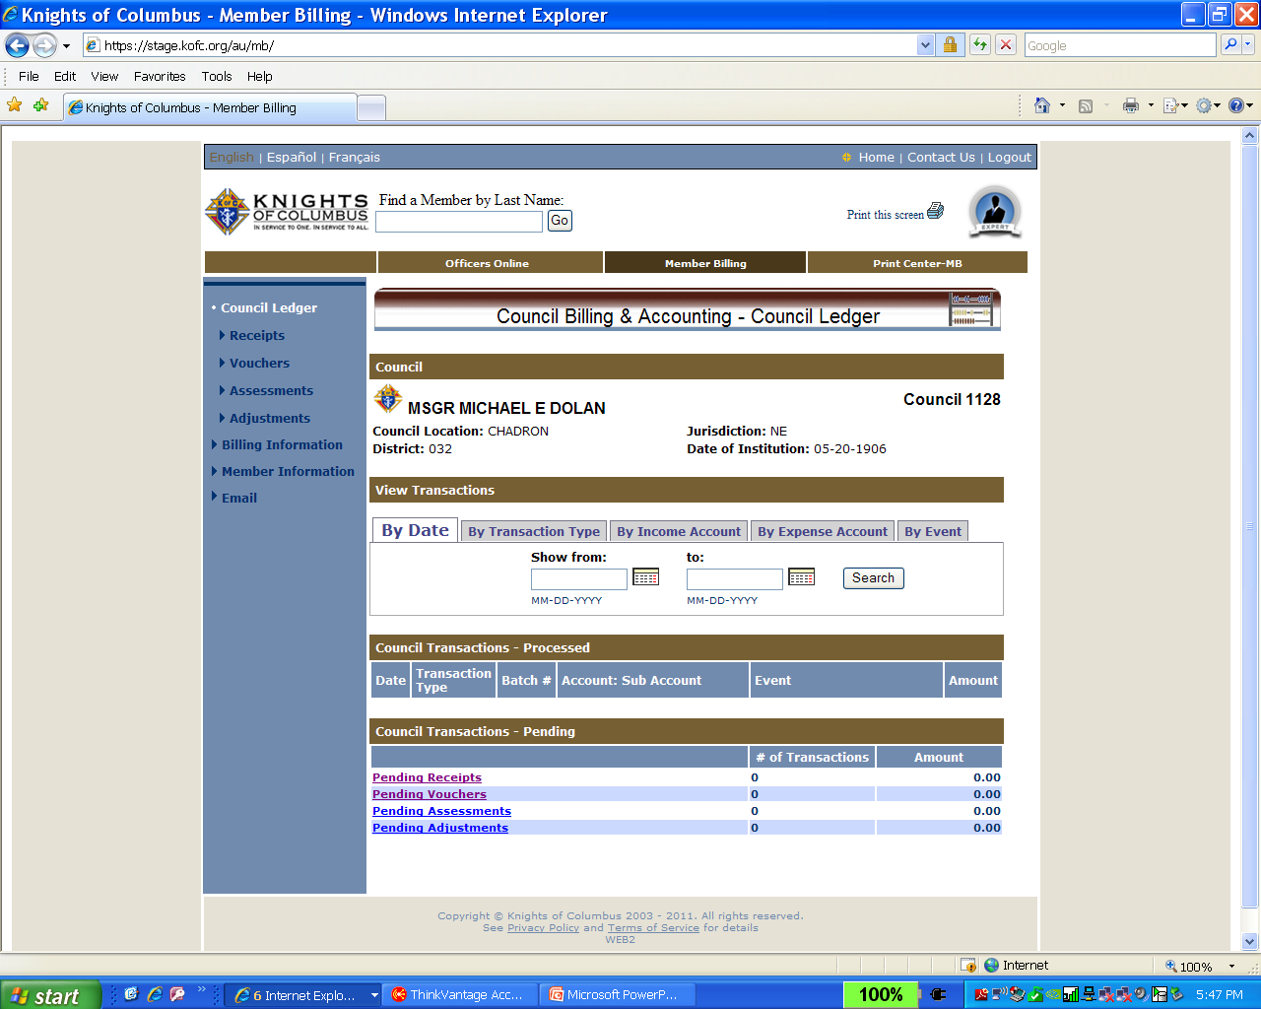

Slide 8
Click on one carat-go back one month, click on two carats-go back one year. Hold on box &
slide down for
previous years
Find dates an easy way…

Slide 9
Member Billing
Billing Information and Set-Up

Slide 10
US Dollar
Set-up billing information for members and vendors.
Note: Remittance name now changeable

Slide 11
Dues statement now shows the optional dues remittance name.
O’NEILL KNIGHTS OF COLUMBUS #701
Expense report showing accounts and events information.

Slide 12
Determine regular and honorary assessment amounts
You must also update individual member records to include them in the sub class
Sub classes and amounts
Add classes here
Seminarian
$5.00
Establish the class list and amounts to assess
Notes:
After setting up sub classes, you must go to individual member records to place the members into the sub class

Slide 13
Income Accounts- Supreme and added Council Accounts

Slide 14
Income
Expenses
Activities
Assessments

Slide 15
additional expense accounts added to the system prior to entering vouchers. The procedure is the same as with the income accounts.
Do the same for expense accounts as was done for the income accounts.

Slide 16
added to the system prior to entering vouchers. The procedure is the same as with the income accounts.
Add account and sub account by using this feature.
Notes:
When adding expense sub accounts, you may select suggested sub accounts from a drop down list for Church Activities, Community Activities, Youth Activities. These match the charitable disbursements on the Annual survey of Fraternal Activity Form making it easier to complete the report.

Slide 17
Add events and reasons for assessments

Slide 18
Council Payee and Payor List

Slide 19
To add a Payee / Payor click on the tab Add Payee/Payor Enter name, address and other contact information. Adding an address here will show the address on the voucher form.

Slide 20
Member Billing
Member Information Set-Up and Contact Record

Slide 21
Notes:
Scroll down to see Credit and Charge Adjustments for member ledger. There you can make manual adjustments for dues, initiation fees, Special and Miscellaneous assessments.

Slide 23
1
Brought forward from MM
Bottom portion of member ledger

Slide 24
Member record of emails and add notes
Email a member and show history of emails sent.

Slide 25
Establish record of correspondence

Slide 26
Reconcile transferred members balance due

Slide 27
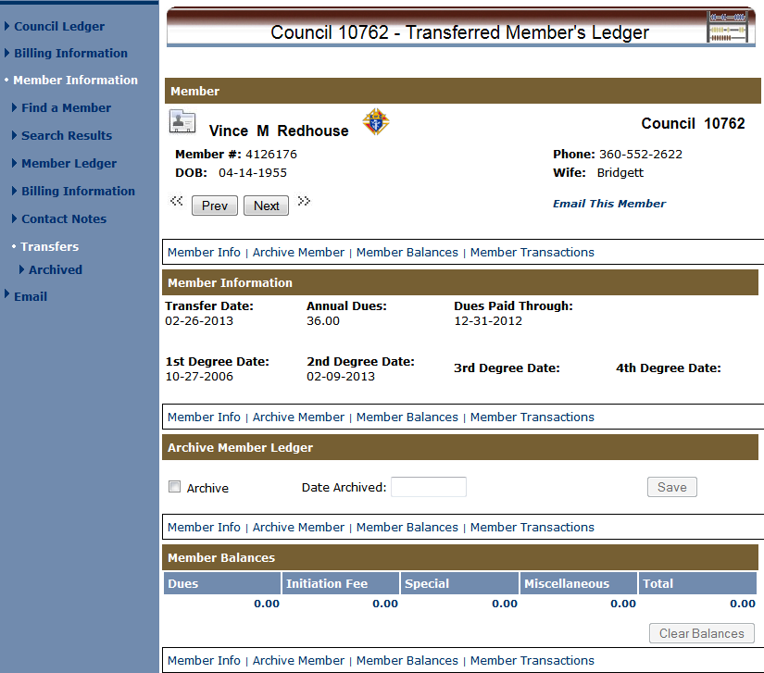
Notes:
After completing the Account Adjustment for Transfer form, you may archive the transfer record. If there were balances due, you can clear them using the Clear Balances button.

Slide 28
Member Billing
Council Ledger-
Enter Assessments

Slide 29
Billing period
Billing effective date
Shows billing amounts to be assessed – See class list for input options
Notes:
Click Assess dues when done setting up. Caution, be sure to select the correct billing period the first time you generate an assessment.

Slide 30
Expiration date
Special assessments. Example: Culture of Life

Slide 31
Pending assessments. Culture of Life

Slide 32
Screen after processing assessments

Slide 33
Billing cycle and Update options

Slide 34
Assessments from 12/15/09 thru 12/15/10 in total dollars

Slide 35
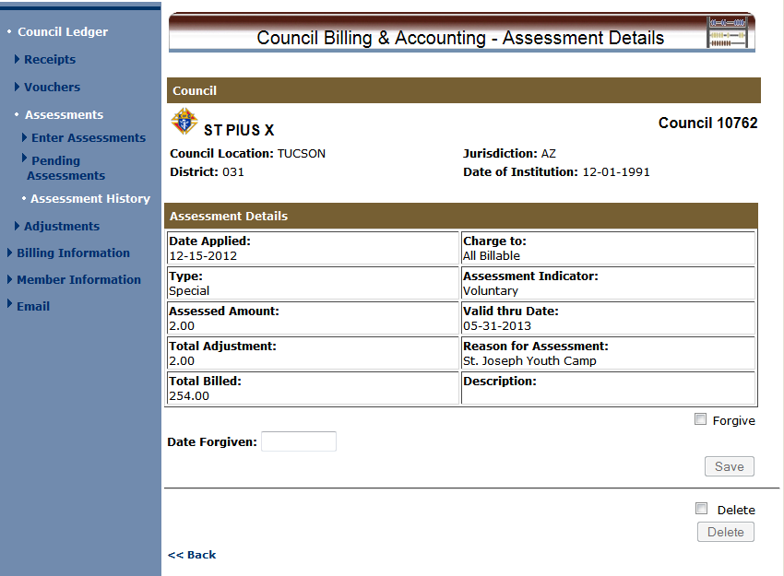
Forgive Voluntary Assessments when date is reached
Can Un-do an assessment
Notes:
You cannot delete an assessment when there are already processed receipts associated with it.

Slide 36
Member Billing
Council Ledger-Receipts

Slide 40
it
Record receipts from a member.
Be sure to

Slide 41
Use dues collection tool if remittance matches amount due

Slide 44
Example of dues amount $35.00

Slide 45
Enter receipts from a Payor or Vendor

Slide 46
Notice that Seth owes $80.00; $50.00 arrearage and $30.00 new annual dues amount
First notice for members with last name starting with letter V

Slide 47
Sort Options

Slide 48
Member Billing
Council Ledger-Vouchers

Slide 49
Go to Vouchers – Enter vouchers and find the member (Initial of Last Name and an*) Select your member from the list of members. Date is automatic and the Member/Payee is carried down from the selection results. Enter the voucher amount and click the drop down to fine the account and sub account. If you don’t find one that is appropriate for the expense item then go to add account and enter an additional account. Enter the amount once again, unless this is a split accounting transaction. You may enter the Event or add event if there is not one suitable in the system. Enter a description if you wish and then check split if you are charging this expense to two or three different accounts and events. Then click on save.
To enter a voucher use this feature. Find Member or Payee and enter the amount and add account or subaccount and SAVE.

Slide 50
You may wish to track expenses/revenues by event. Go to add events and add council events. Identify revenue or expense by event pull down. You may add an event by clicking on the add event tab on the bottom of slide

Slide 51
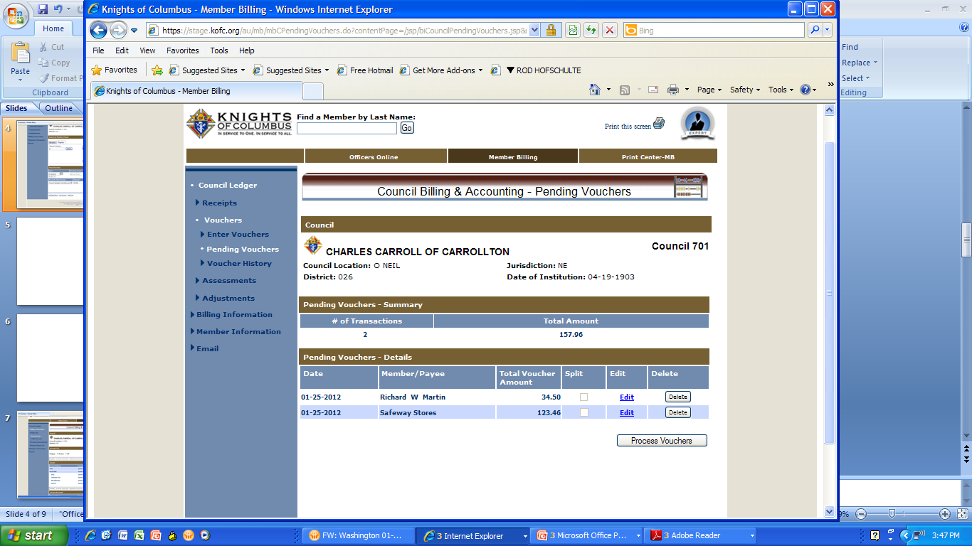
Slide shows a record of the two pending vouchers not yet processed

Slide 52
Go to Member B
Go to Print Center-MB and click on voucher reports, Treasurer – Voucher Reports and Tab 2 Report of Pending Vouchers to see any vouchers pending and produce a report for the council business meeting.

Slide 53
This report shows the two pending vouchers to be read and approved at the regular business meeting.

Slide 54
Vouchers now processed and are shown in voucher history

Slide 55
After approval by council membership, vouchers are now ready for signatures of the officers shown below and processing for payment.

Slide 56
Voucher reports can be generated by date range and by batch number.

Slide 57
Expense report showing accounts and events information.

Slide 58
Number is high- lighted, therefore voucher detail is viewable and will allow for entering a check number.
Expense report showing accounts and events information.

Slide 59
Input check number after processed in voucher history
Expense report showing accounts and events information.
Save it here

Slide 60
Expense report showing accounts and events information.
Check number

Slide 61
Member Billing
Council Ledger-
Enter Adjustments

Slide 62
Accounting adjustment to reflect sales tax expense
Notes:
You can use Adjustments to add, remove or change Event associated with a transaction

Slide 63
Pending adjustment from previous page

Slide 64
Sort in several formats
Adjustment history from 11/30/09 to 11/30/10

Slide 65
How do you feel so far ????

Slide 66
Member Billing – Print Center Reports for Financial Secretaries

Slide 68
Treasurer’s Report of Receipts Top of page

Slide 69
Report of Receipts – Transaction detail

Slide 71
Notes:
Under Billing, you select First Notice, Second Notice, Intent to Suspend for councils. First Notice, Second Notice and Final Notice for Assemblies.

Slide 72
Member dues statement
Notes:
Recommend preparing a File Copy first and save it. After assuring that information is correct, proceed to generate Mail and Email notices. Email notices are sent at once as an email attachement. Mail notices must be printed and mailed. The Financial Secretary does this.

Slide 73
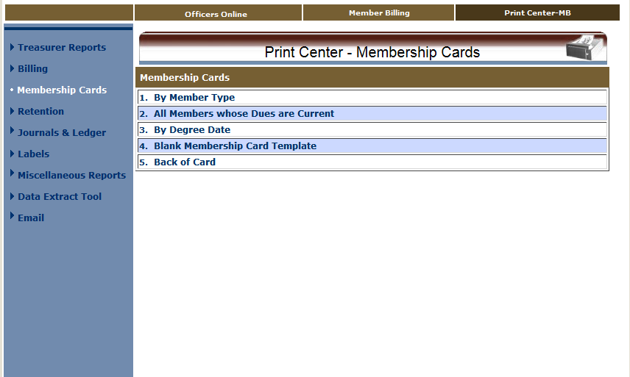

Slide 74
Preparing to print membership cards

Slide 75
Membership cards printed on card stock provided by Supreme
Notes:
You can print the cards on blank card stock #4817 for councils, #4818 for assemblies

Slide 77
Blank templates available to print separate cards
Notes:
You can manually type in the name, member number, degree and dues paid to date.

Slide 78
Wait to print up to 8 at one time by setting date range. Example page follows

Slide 79
Example of four on a page

Slide 80
Select information you want printed on the back of the card

Slide 81
Information printed on the reverse side of each member’s card

Slide 82
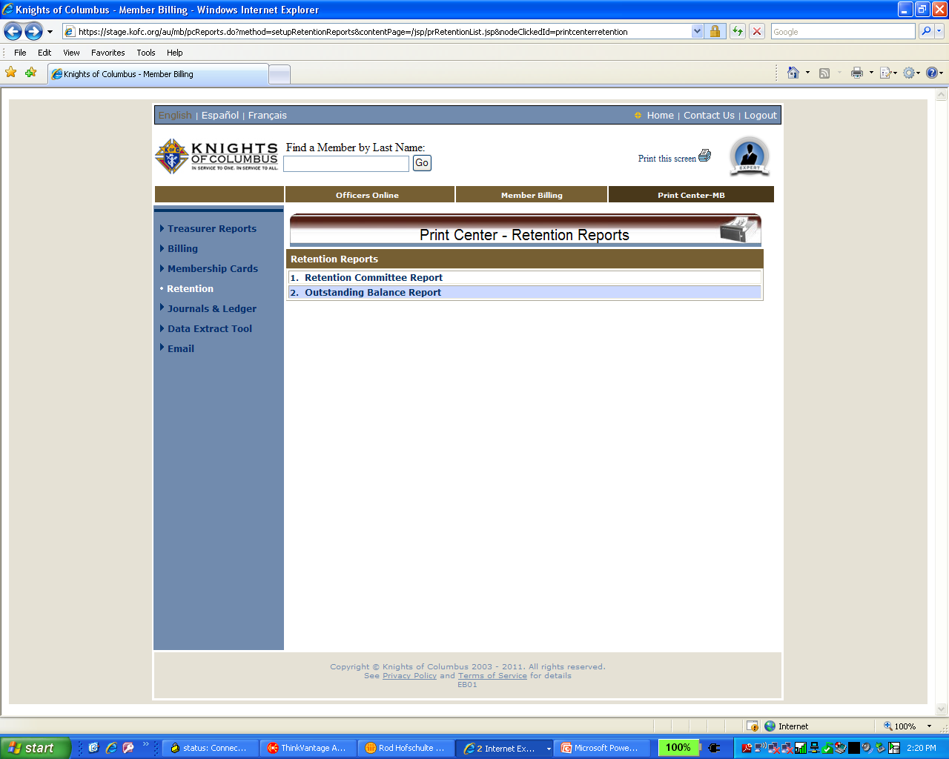

Slide 83
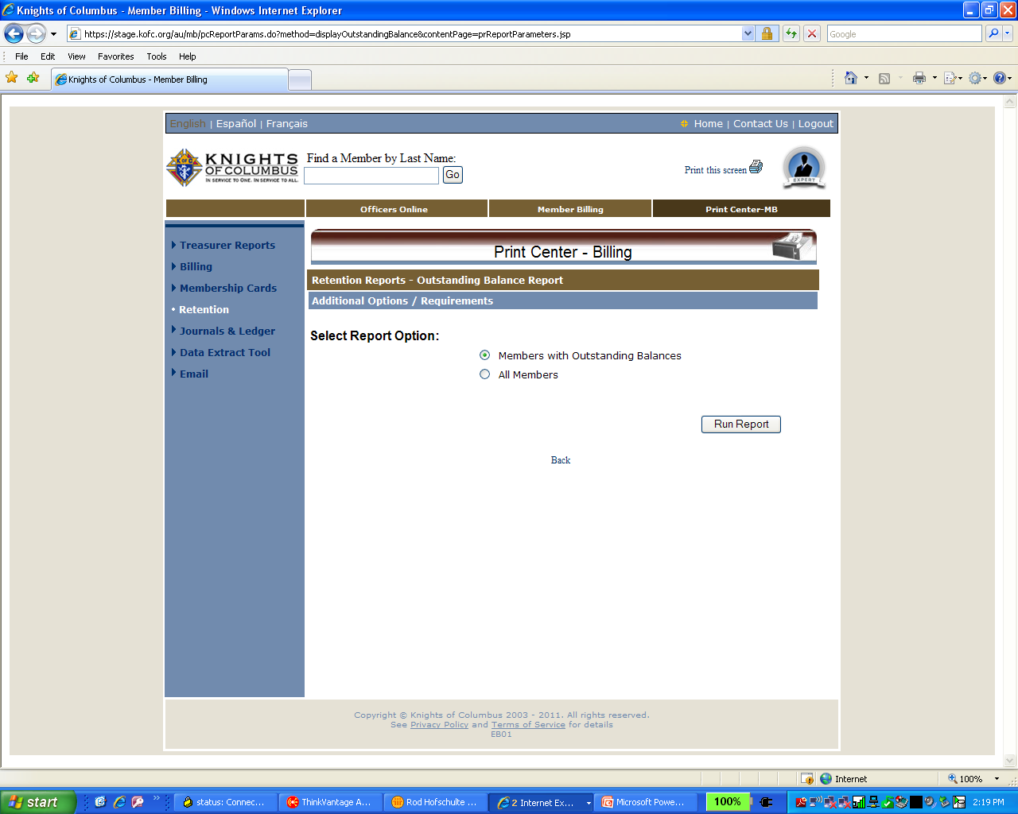

Slide 85
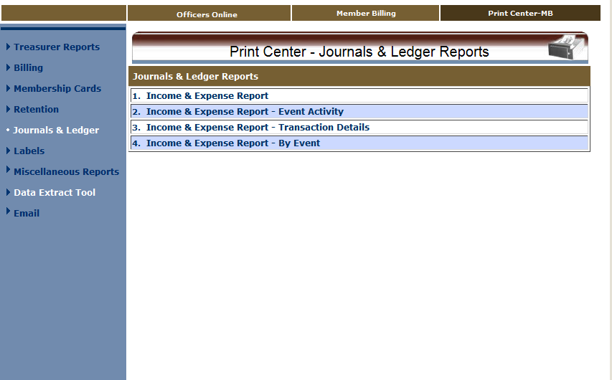
Notes:
Several varieties of Journals & Ledger Reports are available. Try them to see what meets your needs. Can be output to PDF or Excel File.

Slide 86
Income and Expense Report – Income only

Slide 87
Second page of income and expense report.

Slide 88
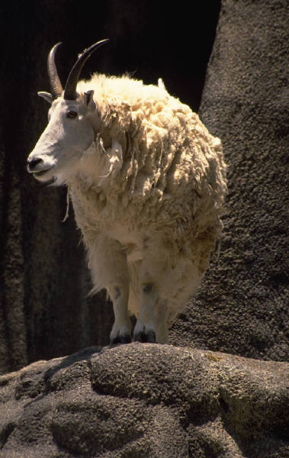
Now, do you feel like you are in control??

Slide 89
Thanks for all you do.
We appreciate it…

