Slide 1
Member Management for Financial Secretaries

Slide 2
Contact Information:
FS Appointments/MM Access
Email: Ann.Moran@kofc.org
Phone: 203 752 4717
Financial Secretary Training Consultant
Email: Pete.Karculias@kofc.org
Phone: 520-975-7362

Slide 3
Officer’s Desk Reference

Slide 4
Officer’s Desk Reference
Officer’s Desk Reference
Use to reference information on
subjects such as;
membership issues,
tax issues,
home corporations,
council and assembly concerns,
social communications

Slide 5
Deacons

Slide 7
Program Calendar

Slide 8
Program Calendar
Calendar of activities and events
Monitor important due dates

Slide 10
By-Laws on Line

Slide 11
Council By-Laws On-Line
Available to GK, FS and Council Advocate.
Template to update or create council by-laws.
Automatically approved once completed and submitted.

Slide 21
Member Management
Section 1
Member information and
member profiles

Slide 22
Member Management

Slide 23
Opening page shows recent changes and additions
Click here to go to Expert site

Slide 24
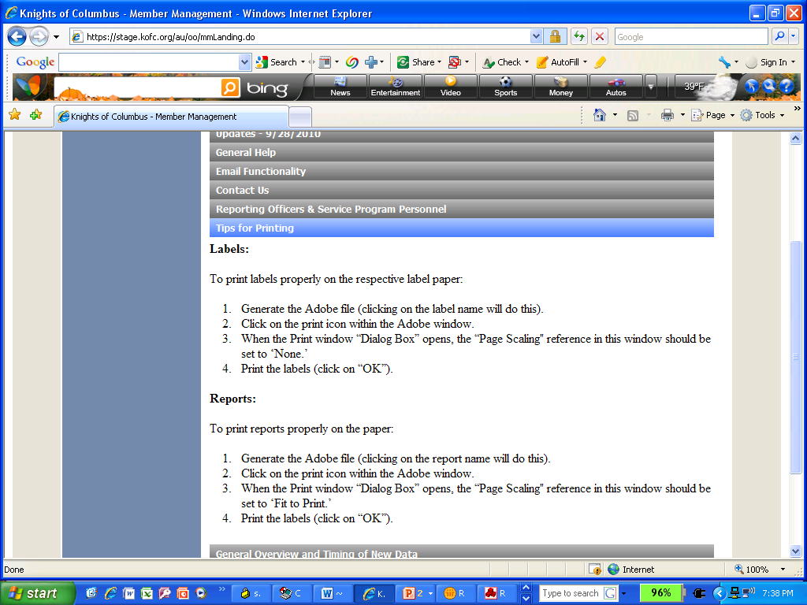
Helpful tips and instructions for understanding functions in this system
Opening Screen:
Shows recent updates and changes to program.

Slide 25
Need Help
See the Expert

Slide 26
Video Tutorials
See Next Slide

Slide 28
Last name or first letter of last name and an asterisk
Regular
Honorary
Honorary Life
Notes:
No longer need to type the asterisk.
Also, you can now choose to search active members all members, or former members

Slide 29
Click on name to select

Slide 30
PSD, FVSM
Pg 1 of 3
Notes:
There is now a Member Information Report that can be generated by clicking the link under the phone number and wife information.

Slide 31
Pg 2 of 3

Slide 32
Always save your work
Pg 3 of 3

Slide 33
Pg. 1 of 2
Comptroller or FS

Slide 34
Enter Proposer #, Name will Appear
Pg 2 of 2

Slide 35
Must show status for name to show above
Single
Married Widower
Divorced
Error correction

Slide 36
Also Update Next of Kin Information and Member Status in Member Billing.

Slide 39
Spouse name shown

Slide 41
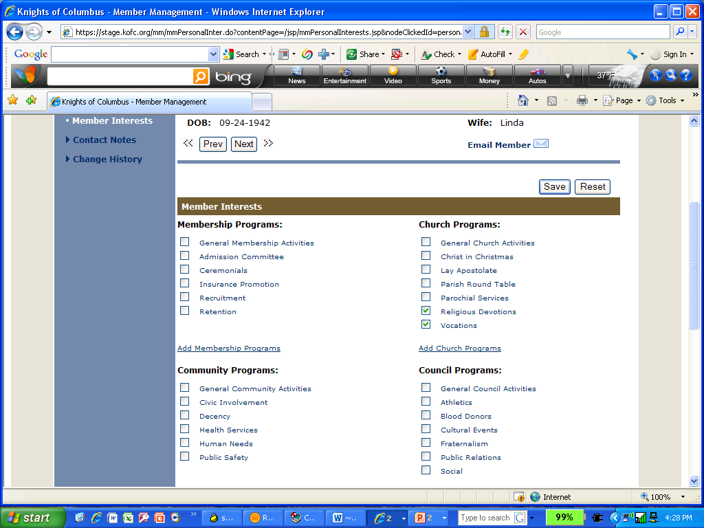
Continued on next slide

Slide 46
Member Management
Section 2:
Council information and administration

Slide 50
DGK Position Open

Slide 51
Now filled
Click Submit when done

Slide 57
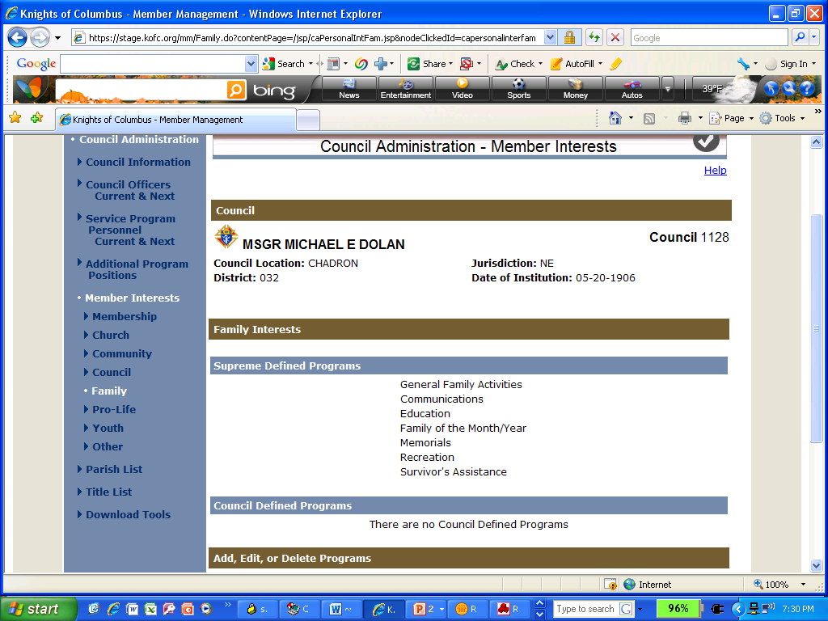

Slide 59
Add parishes from which your council has members, not necessarily those you serve.
Click on search before selecting the Parish
Notes:
Search results will include Eastern Rite churches such as Byzantine Catholic.
There is not a way to remove a parish at present.
You can update Parish membership in the member records. There is not a report of members by parish as yet.

Slide 60
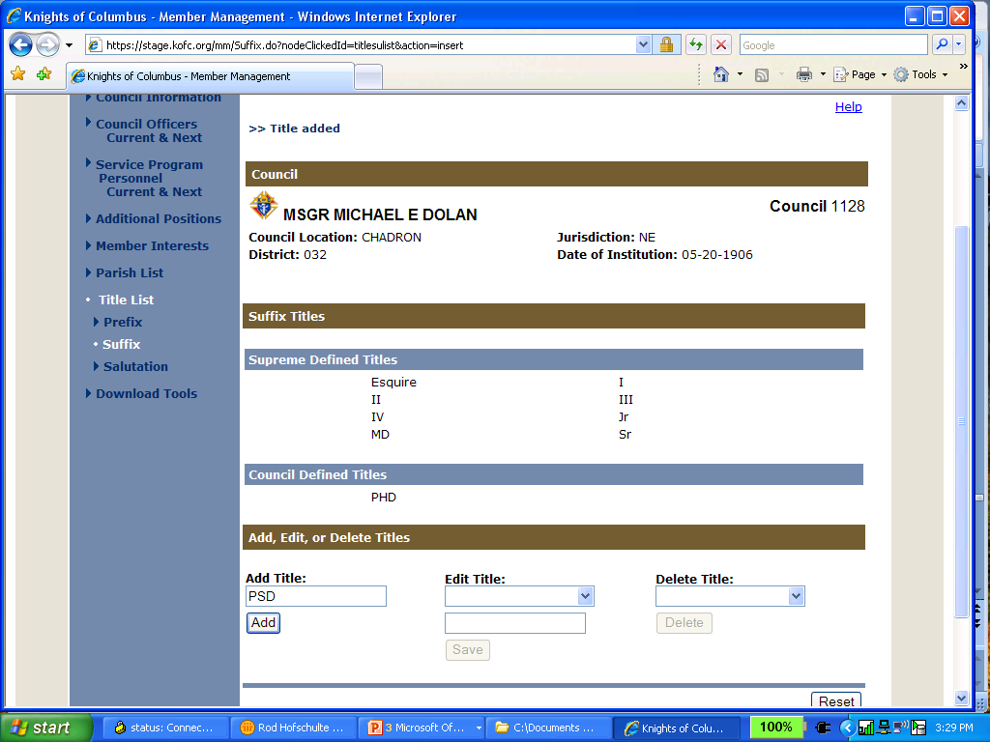

Slide 63
Member Management
Section 3:
Print Center Reports

Slide 64
Notes:
14. Membership Information Reports is newly added

Slide 65
Notes:
This is the report of officers. These were submitted to Supreme when you clicked submit on the selection screen. You can download this PDF file on your computer then attach it to an email to send to your DD or State Deputy or anyone else needing a copy.

Slide 67
Notes:
Note that the year is not shown

Slide 70
.

Slide 75
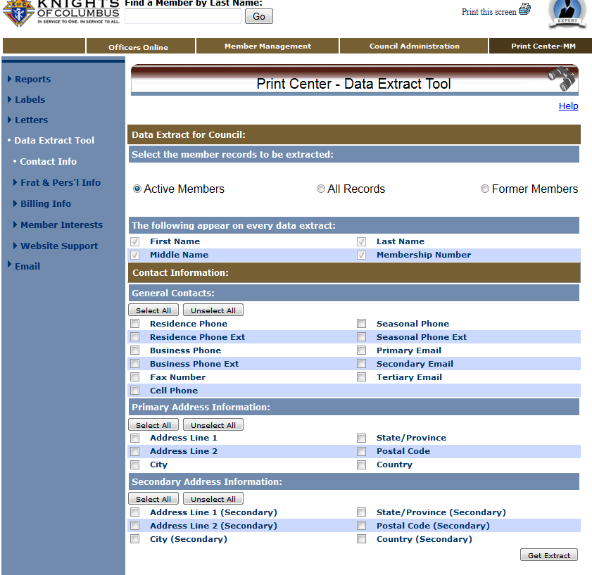
Notes:
Recent update – only Names and membership number included in all extracts

Slide 76
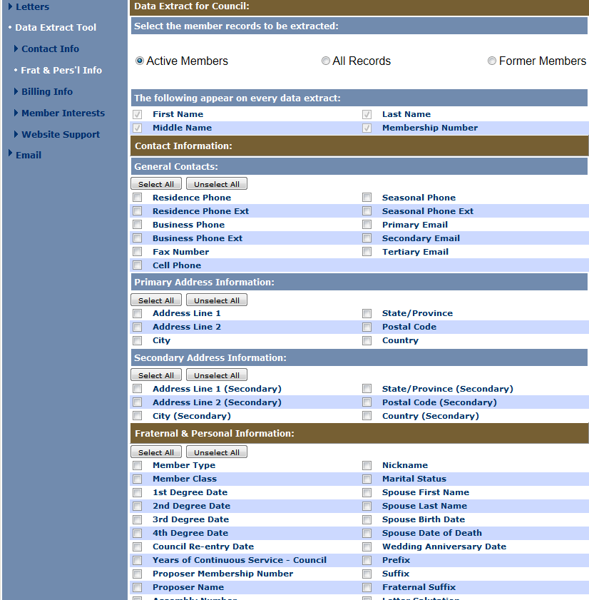
Select
Frat & Pers’l
Info
Years of Continuous Service
Notes:
Member Type and Member Class are now included in Fraternal & Personal Information

Slide 77
Notes:
Member Type/Class no longer included by default

Slide 78
Notes:
Member class is now in the Billing Information

Slide 80
Vocations & Religious Devotions

Slide 81
Devotions

Slide 83
Notes:
Recently added: Ability to email State Deputy, District Deputy and District Grand Knights (not shown on slide)

Slide 86
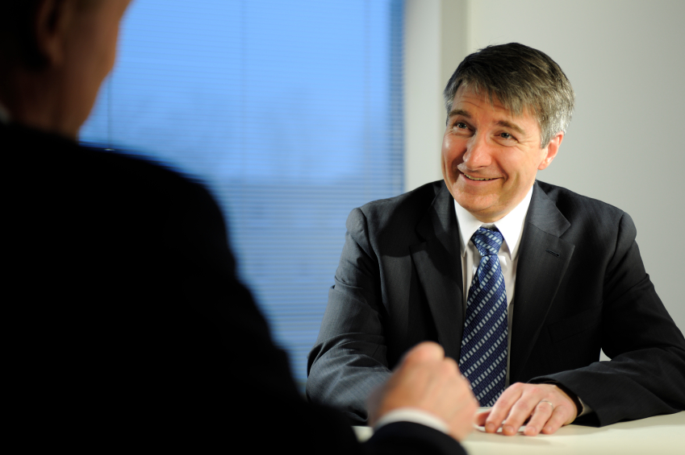
This new MM program will make my job as Financial Secretary much easier and more fun...
Questions

